Slide 1
Databases and the ULM Library
Locating Specific Journal Articles for Education and Curriculum and Instruction Classes

Slide 2
Specific Journal Examples
EbscoHost
Phi Delta Kappan
Education Week
Educational Sciences: Theory and Practice
J-Stor
The Science Teacher
Mathematics Teacher
English Journal
Language Arts

Slide 3
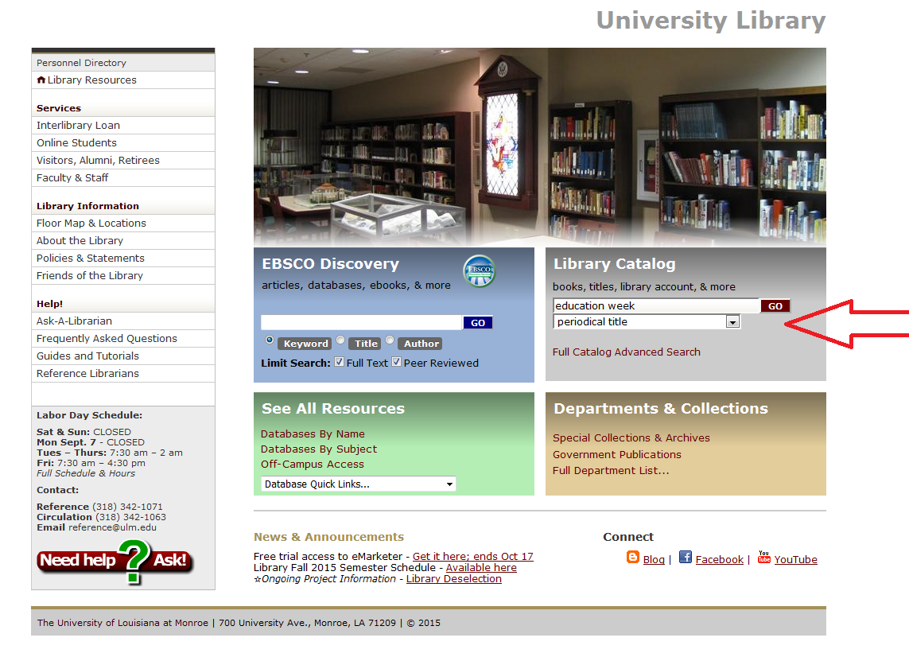
Notes:
I will start with a basic periodical title search of the Library Catalog from the Library Web Page. I want to look for Education Week.

Slide 4
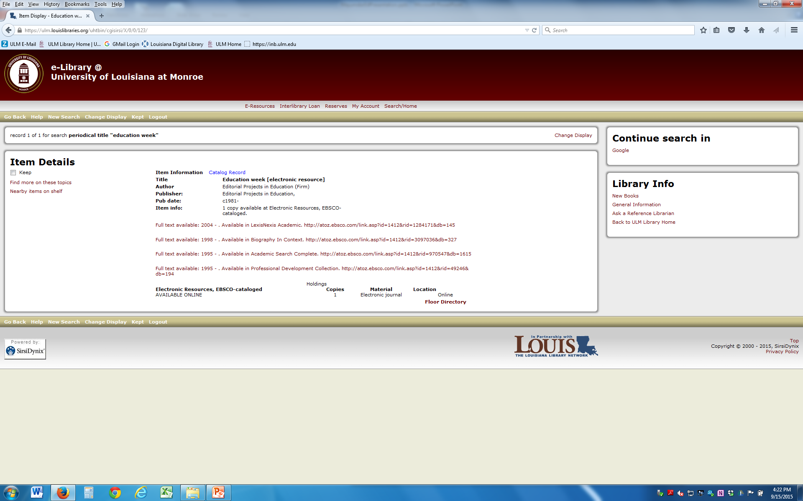
Notes:
I got several links. It shows up in LexisNexis, Biography in Context and Ebsco’s Academic Search Complete and Professional Development Collection. Academic Search Complete is what I choose.

Slide 5
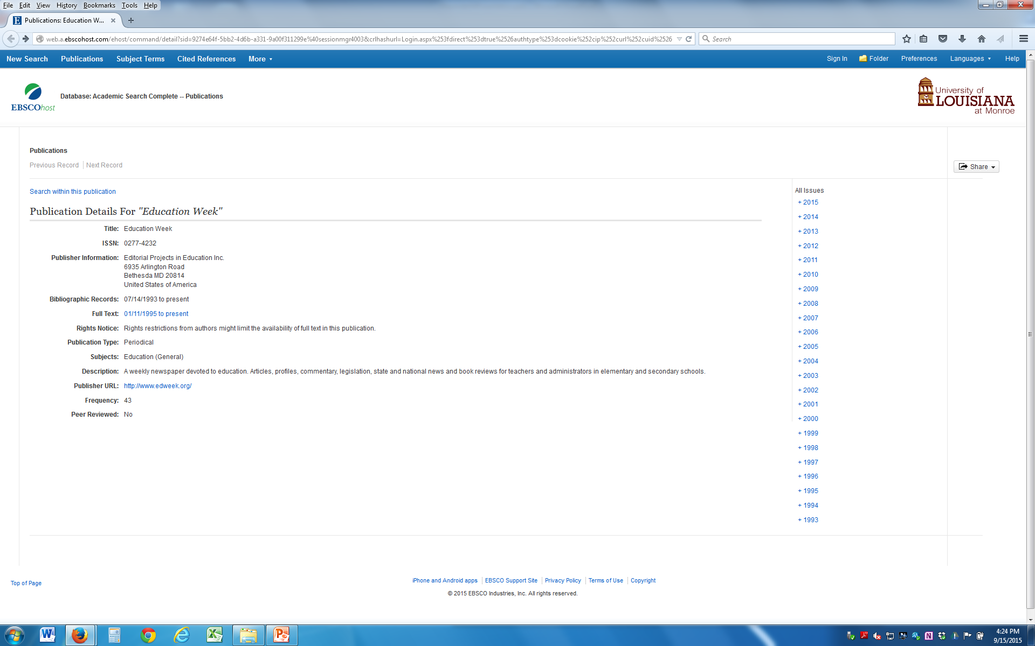
Notes:
This is what you get when you choose Academic Search Complete.

Slide 6
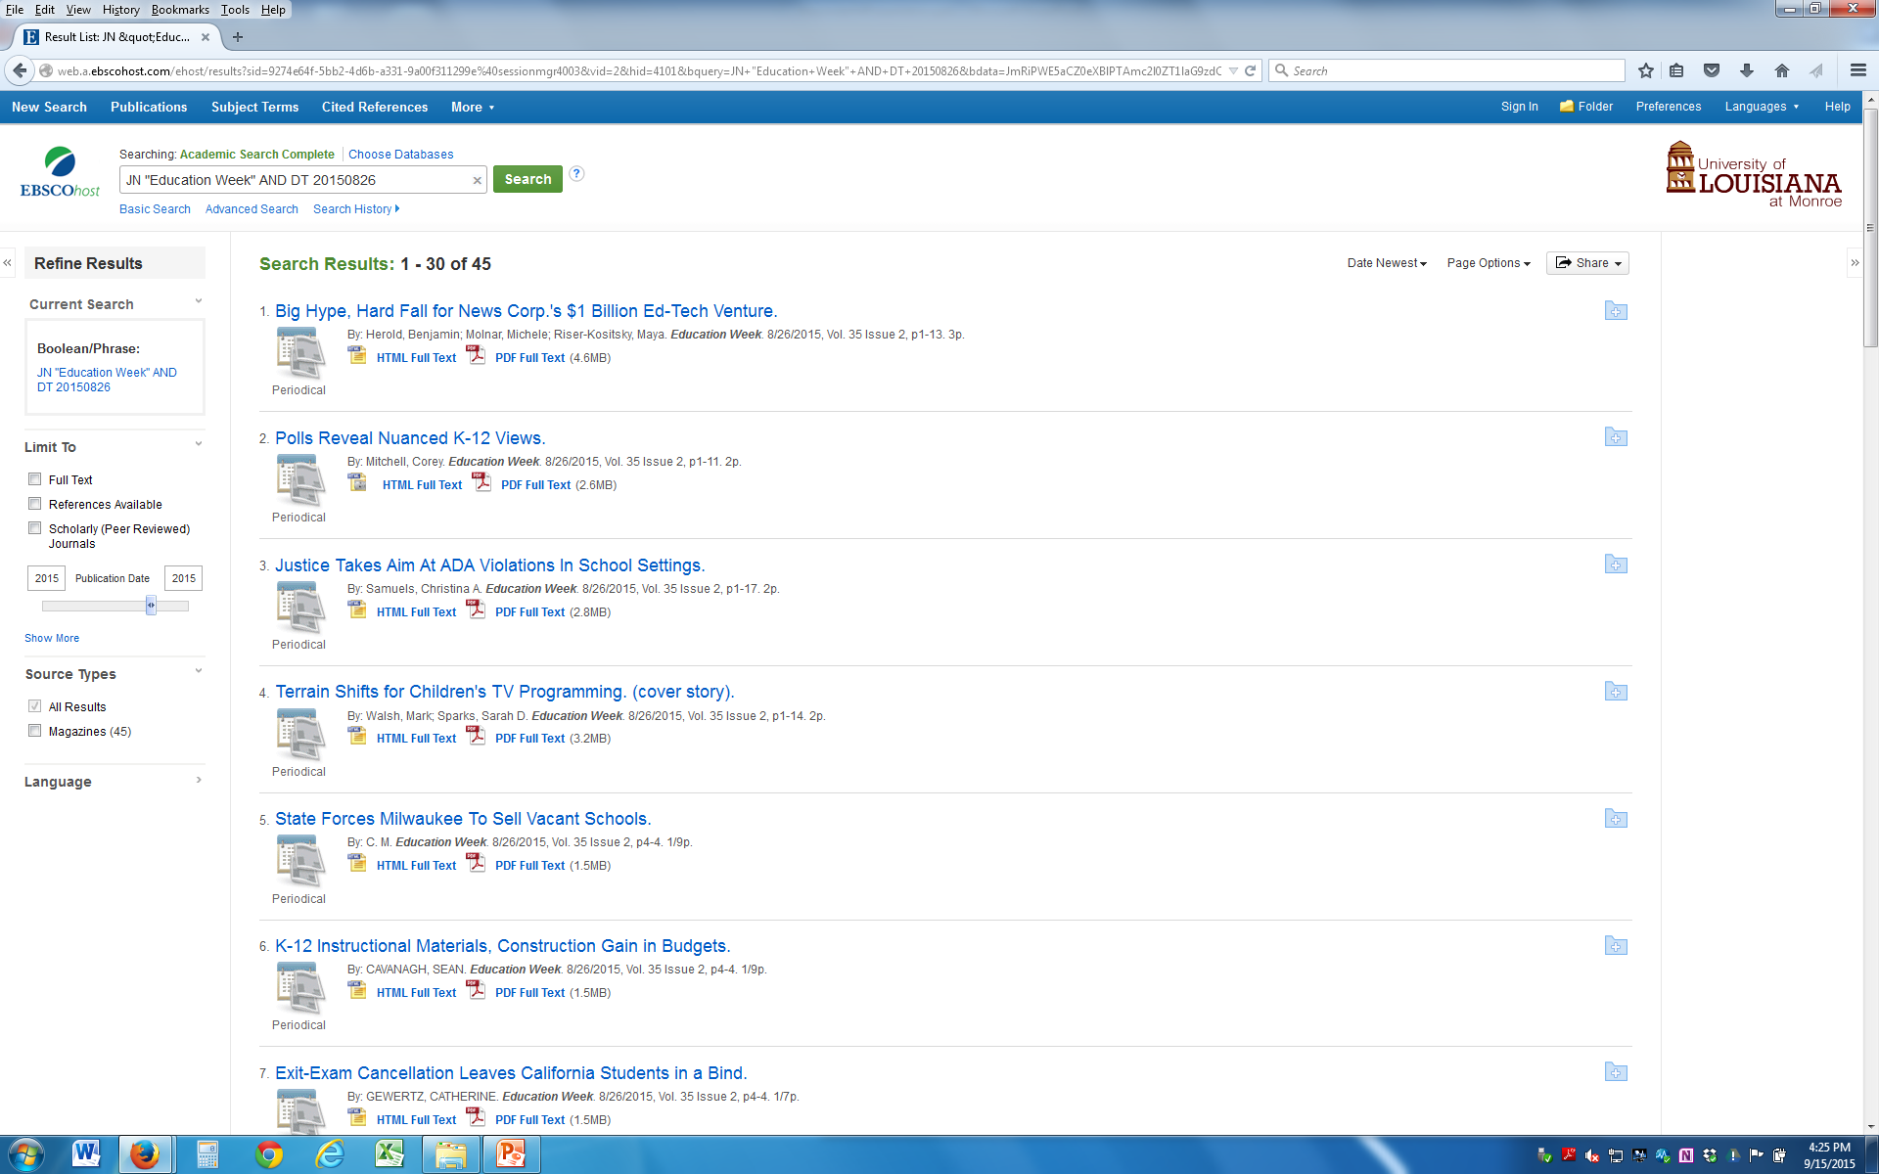
Notes:
This is from the latest issue.

Slide 7
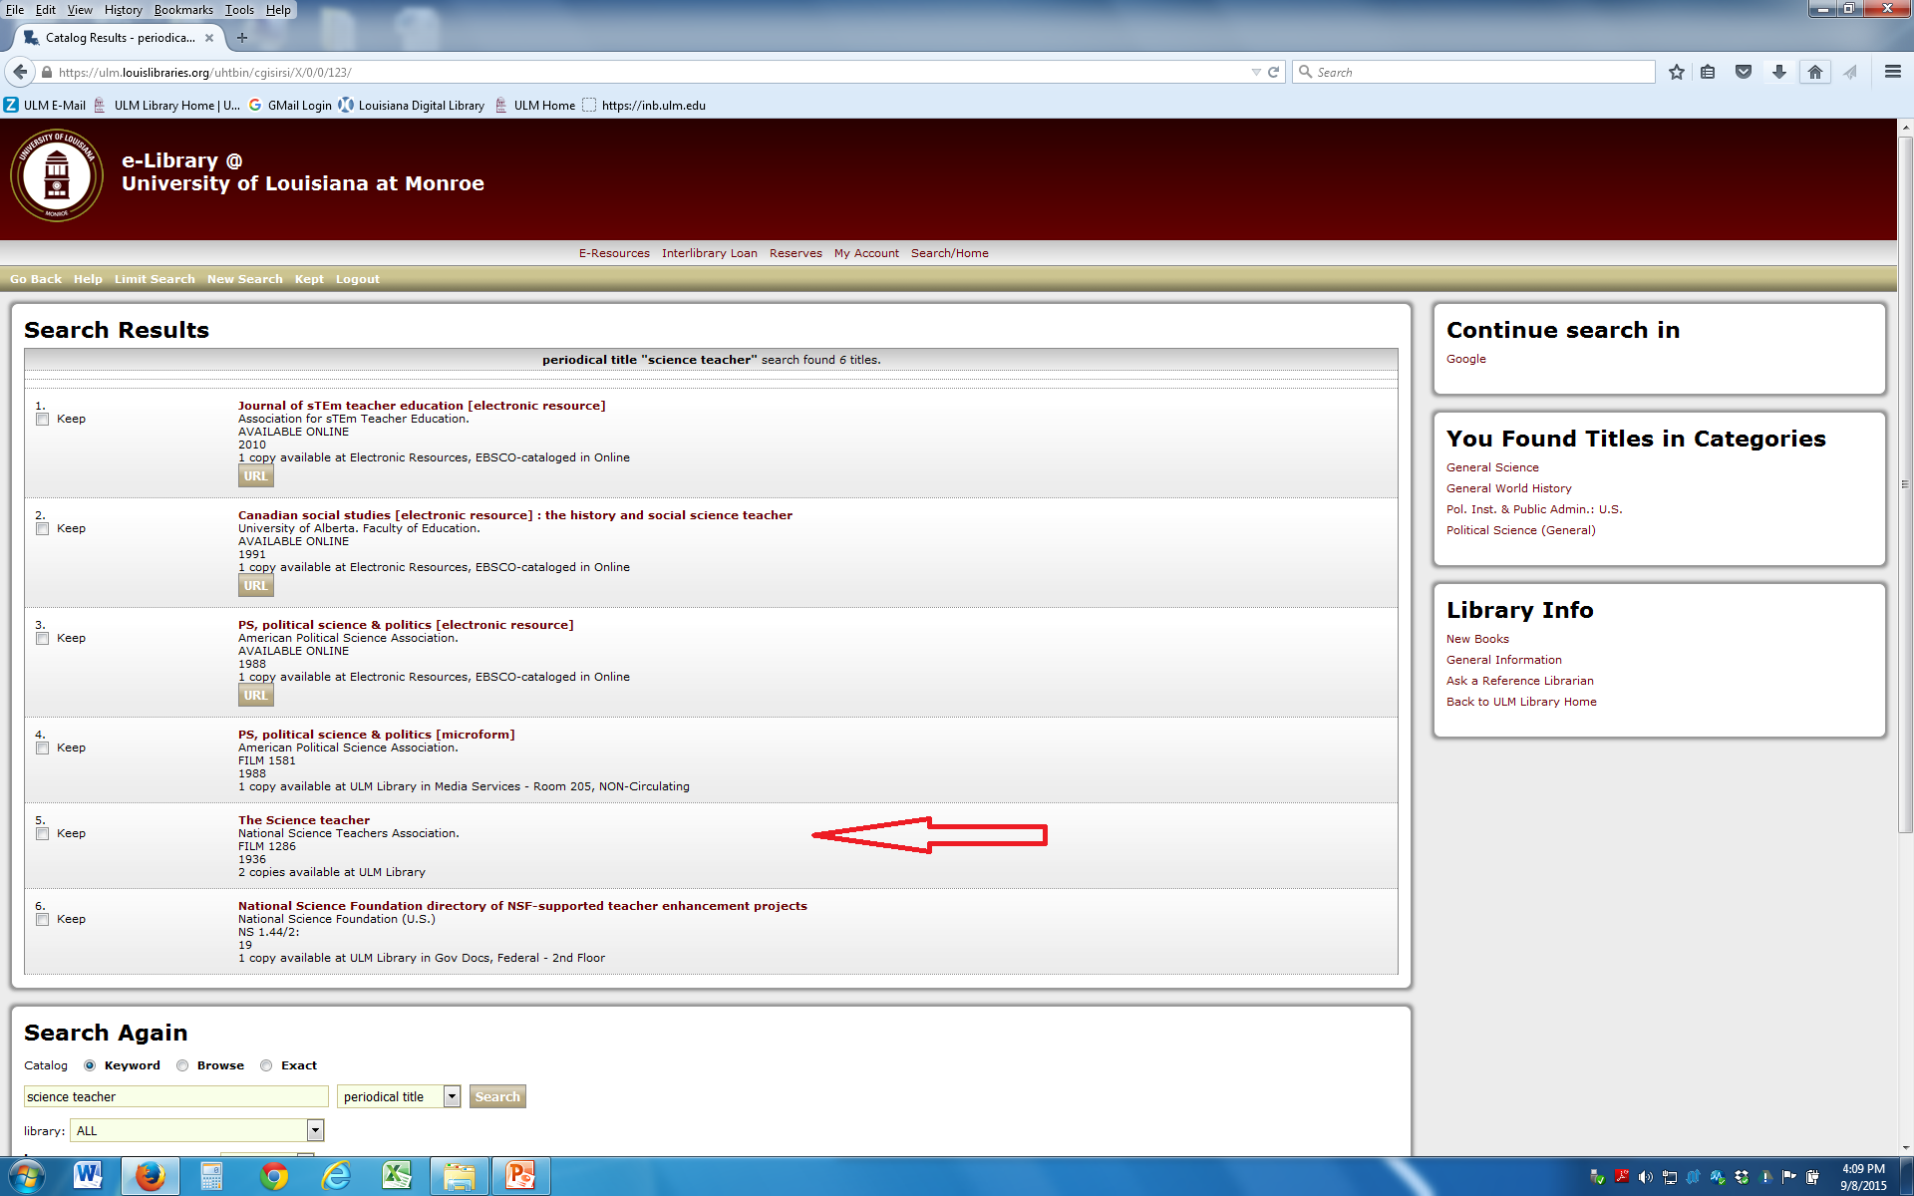
Notes:
Sometimes it is not that easy. A periodical title search for Science Teacher found 6 titles – the one I want shows film only. How many of you are comfortable using film?

Slide 8
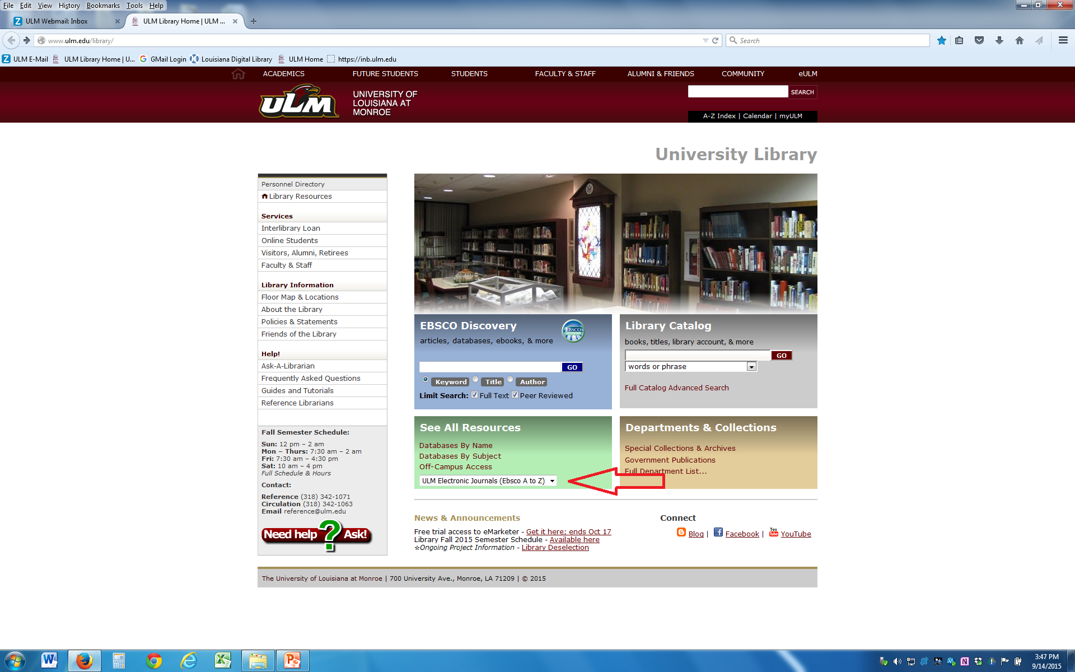
Notes:
Another way to search for your title is from the Ebsco A to Z list of databases.

Slide 9
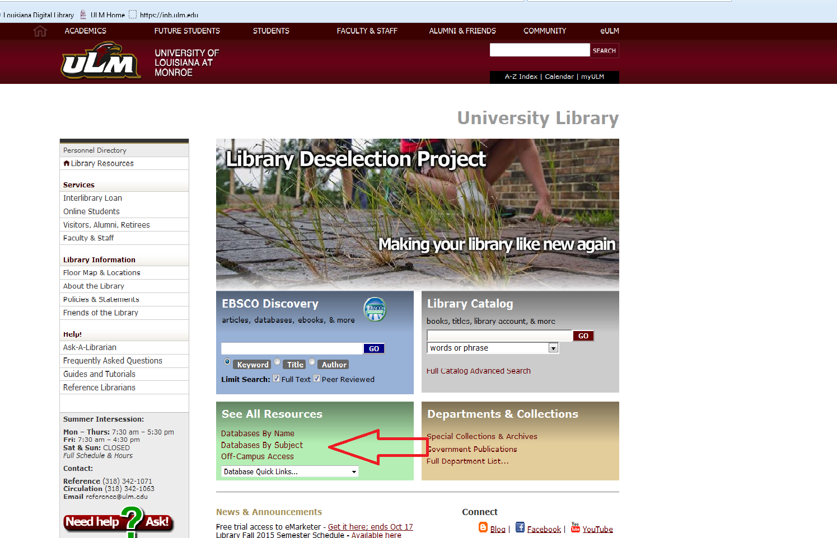
Notes:
And searching for specific databases.

Slide 10
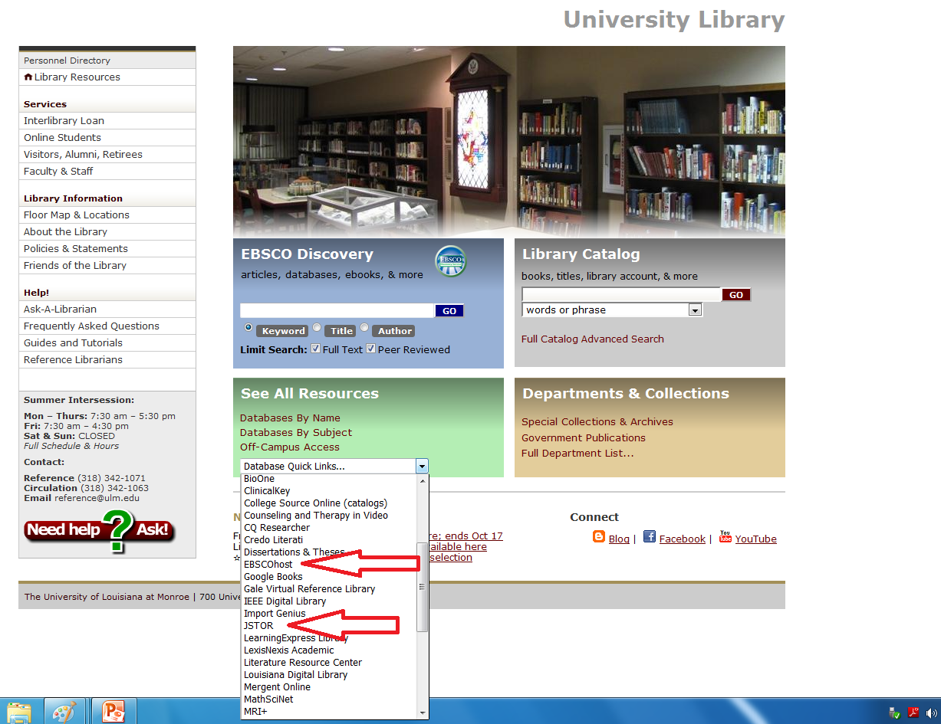

Slide 11
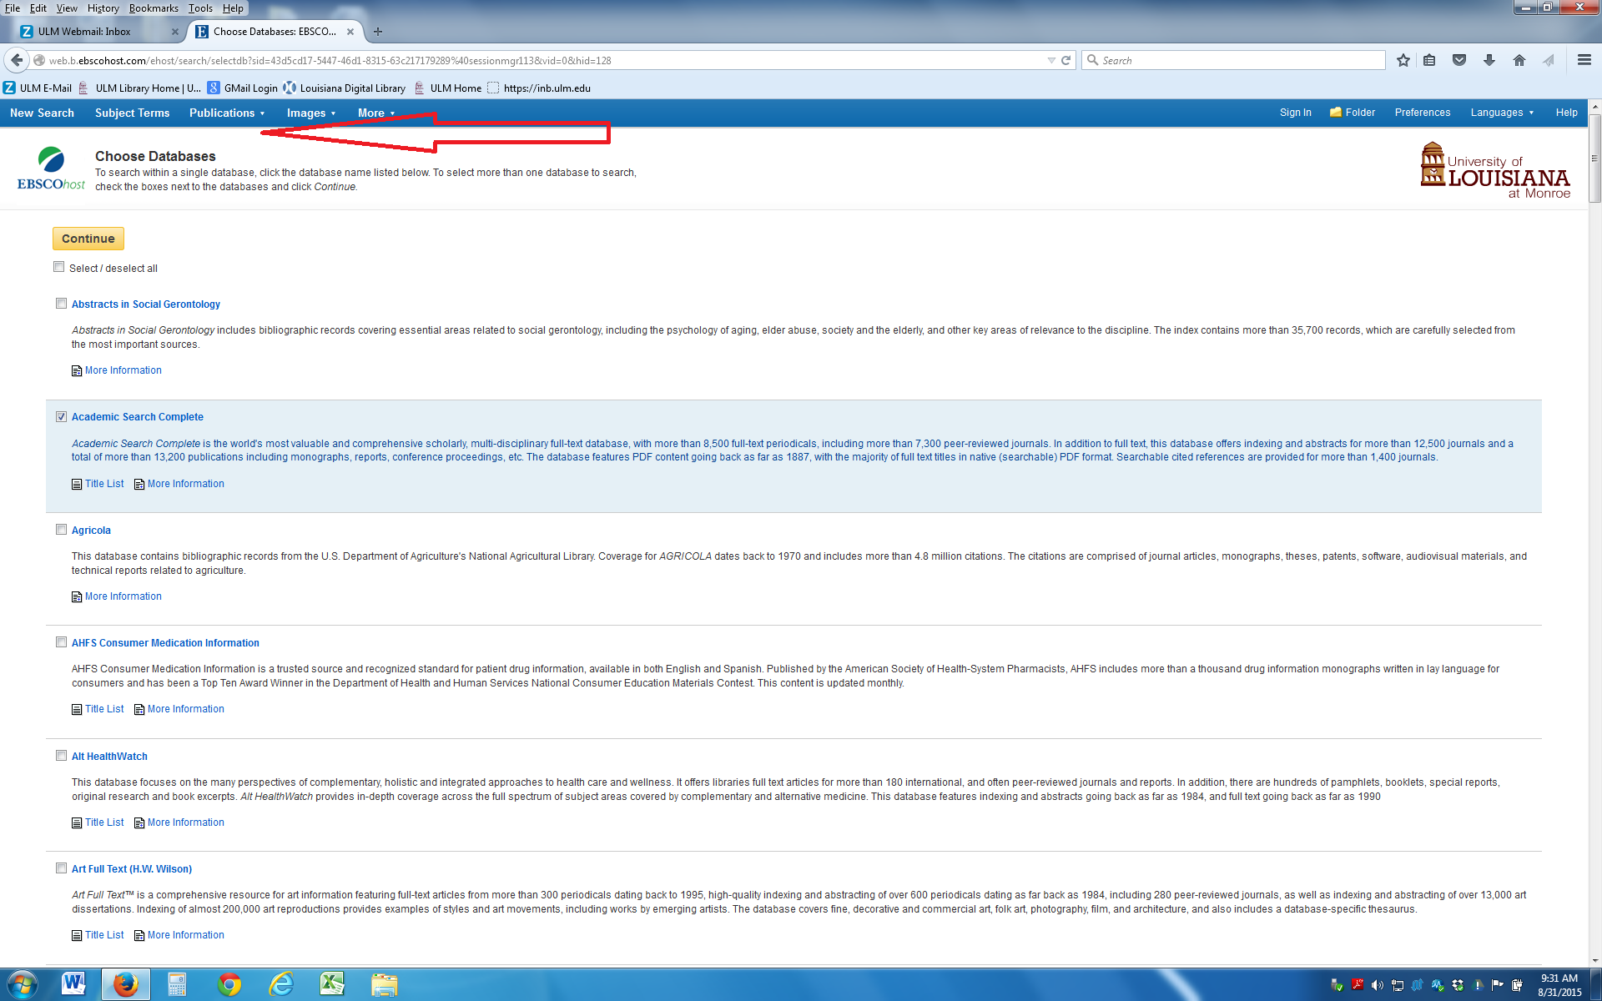
Notes:
You can search Ebsco by publications

Slide 12
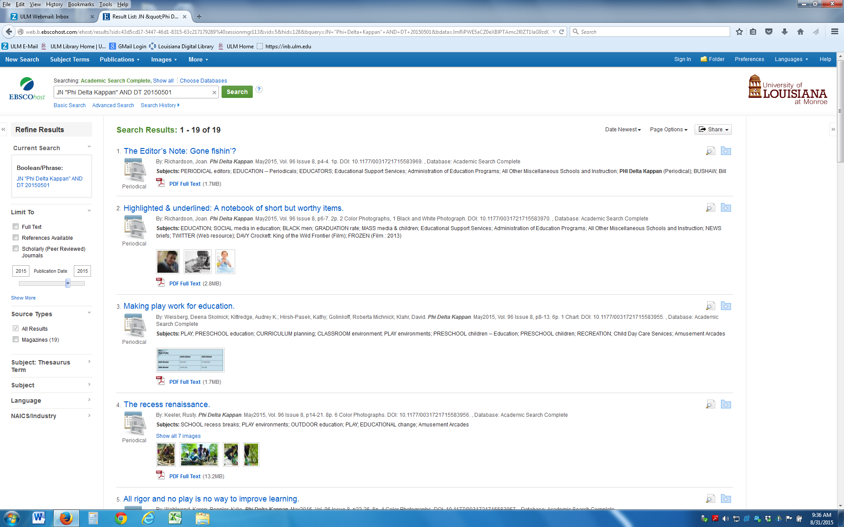
Notes:
This is a search for Phi Delta Kappan that I limited to 2015 so I could see the new articles.

Slide 13
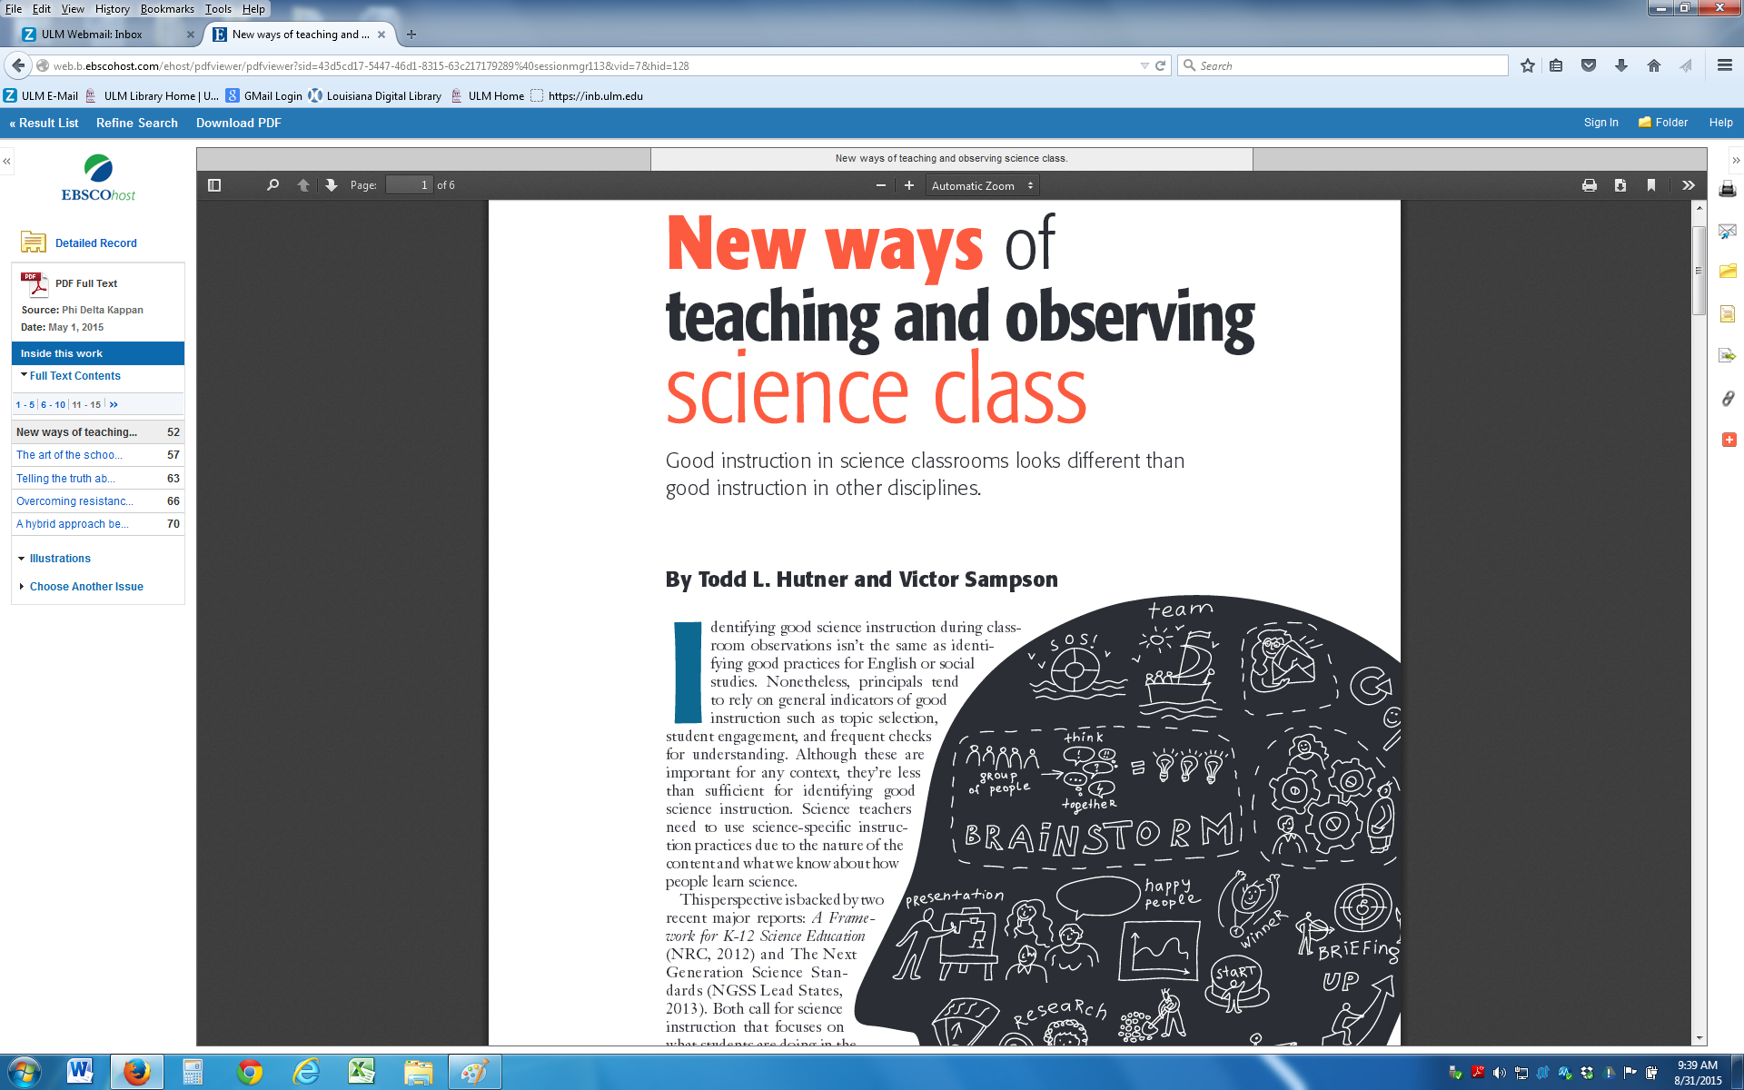
Notes:
This is a pdf of the article

Slide 14
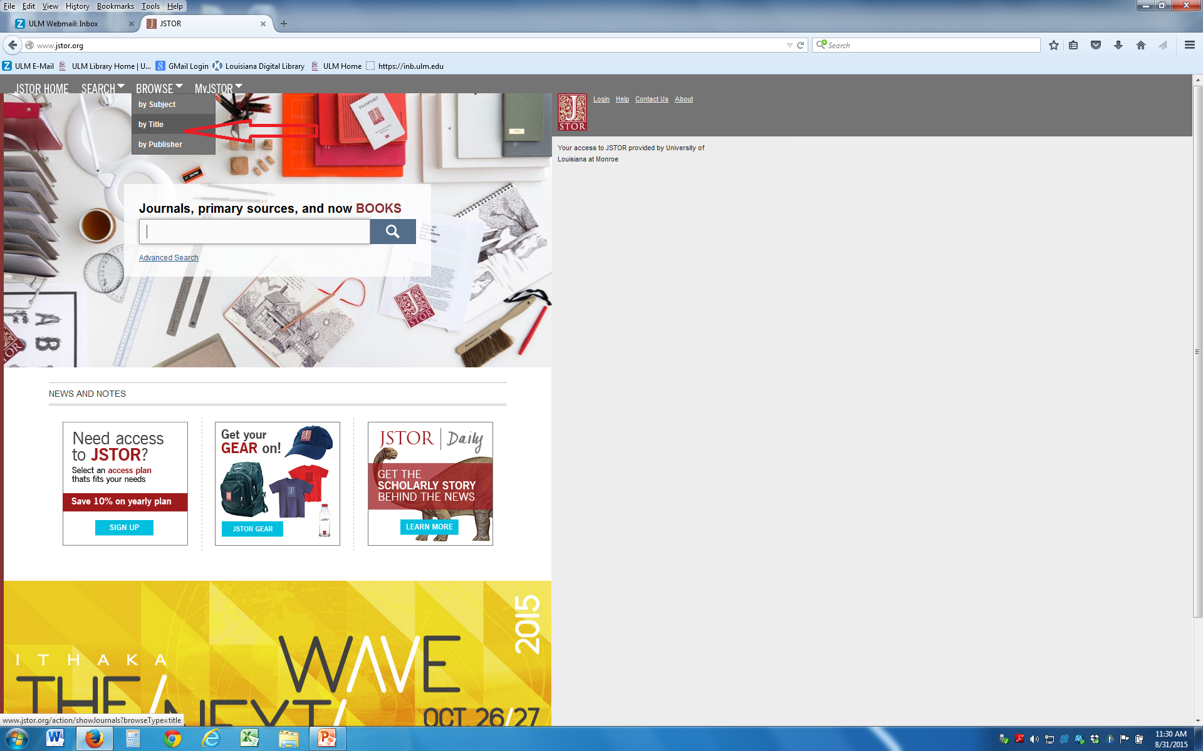
Notes:
I can search Jstor the same way - title

Slide 15
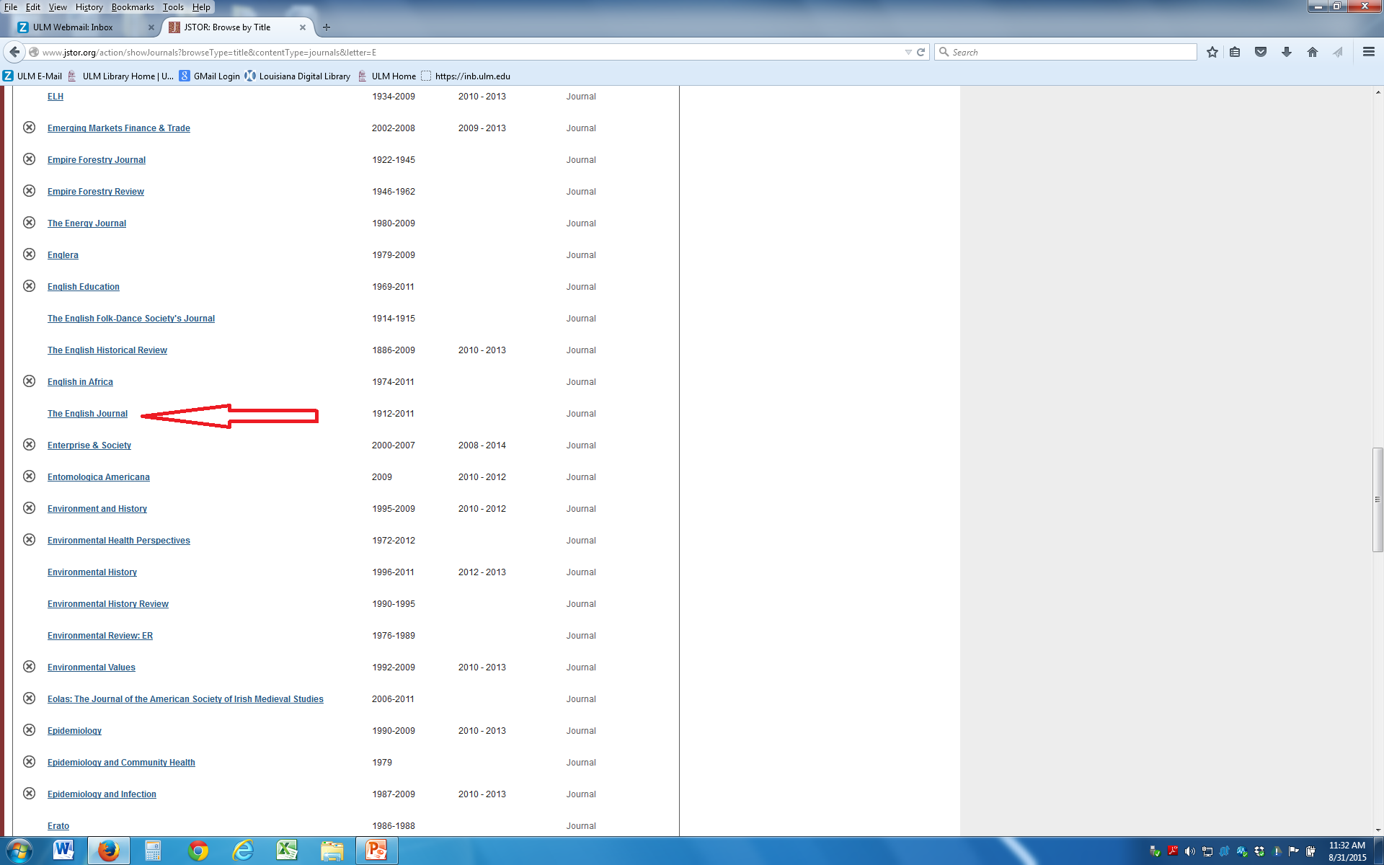
Notes:
This is where I found The English Journal

Slide 16
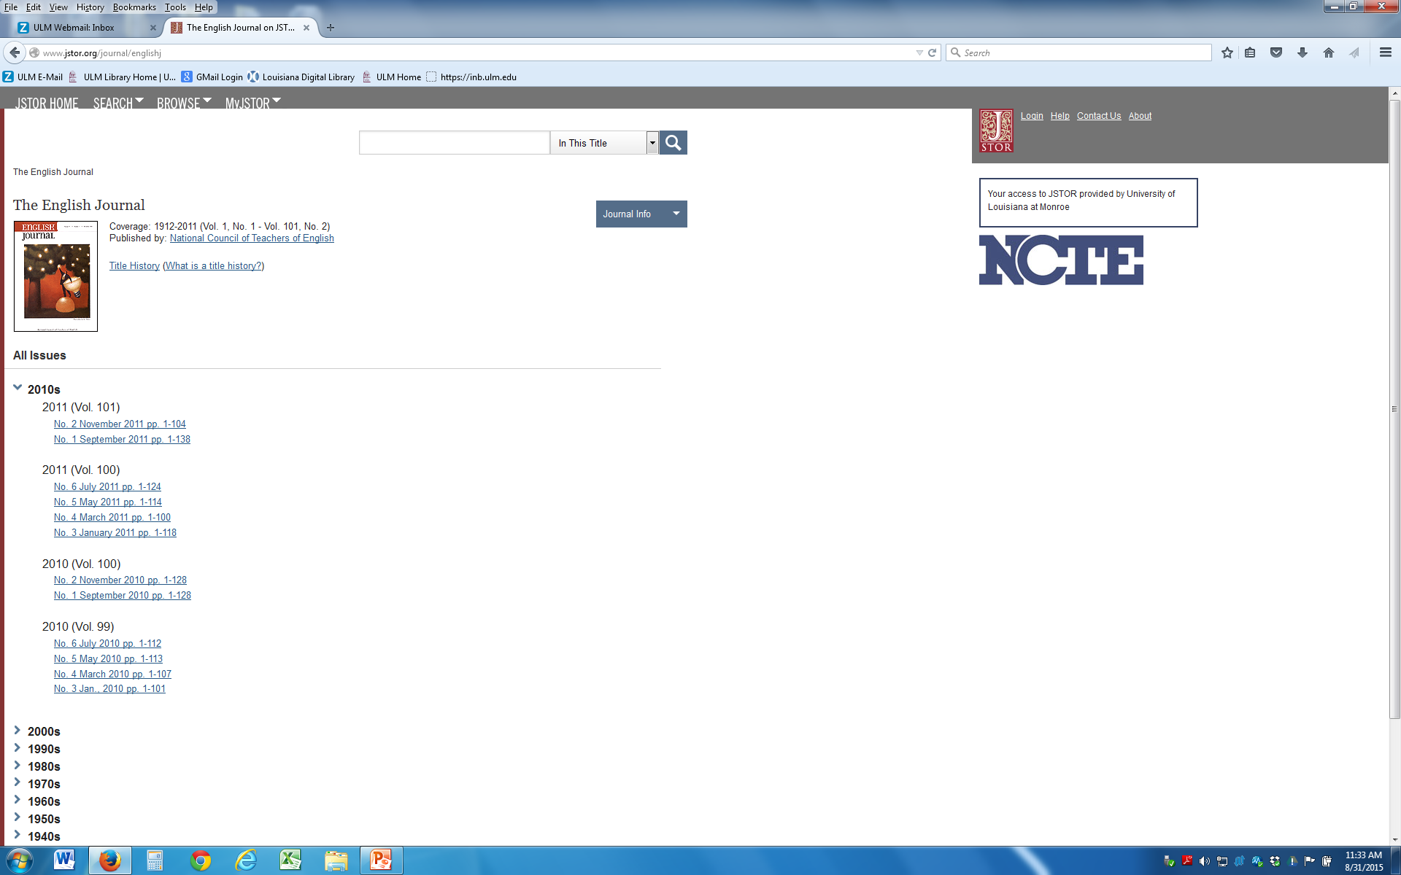
Notes:
I can search by volume – notice the newest is 2010. Some of the titles are not available through the databases until they are older. This is one of those titles.

Slide 17
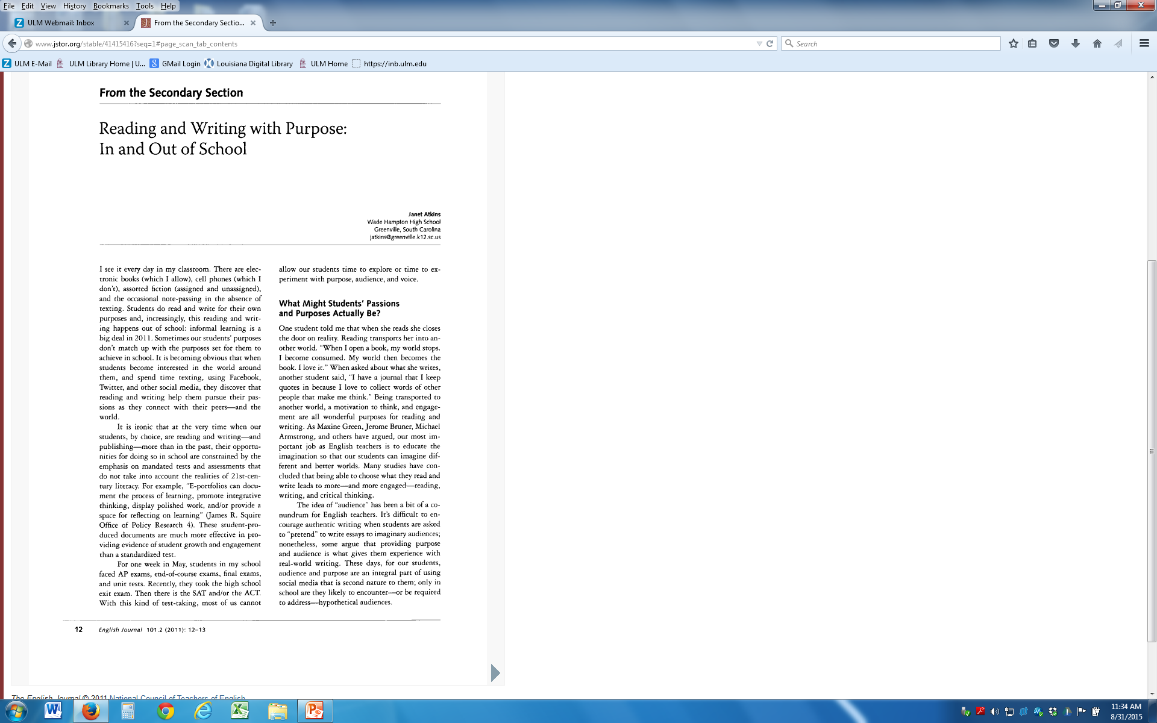
Notes:
Here is my article.

Slide 18
EbscoHost
Title
Availability
Phi Delta Kappan
Education Week
Educational Sciences: Theory and Practice
Full Text
1995 – Present, Full Text
2002 – Present, Full Text
Notes:
EbscoHost has these issues of these titles.

Slide 19
J-Stor
Title
Availability
The Science Teacher
Mathematics Teacher
English Journal
Language Arts
- 2011, Full Text
- 2015, Full Text
1912 – 2011, Full Text
- 2011, Full Text
Notes:
Ebsco Host does not have these but J-Stor does.

Slide 20
Tools
Print
Download C
Copy/open in new window
E-Mail
Add to Folder
Cite
Export
Permalink
Share

Slide 21
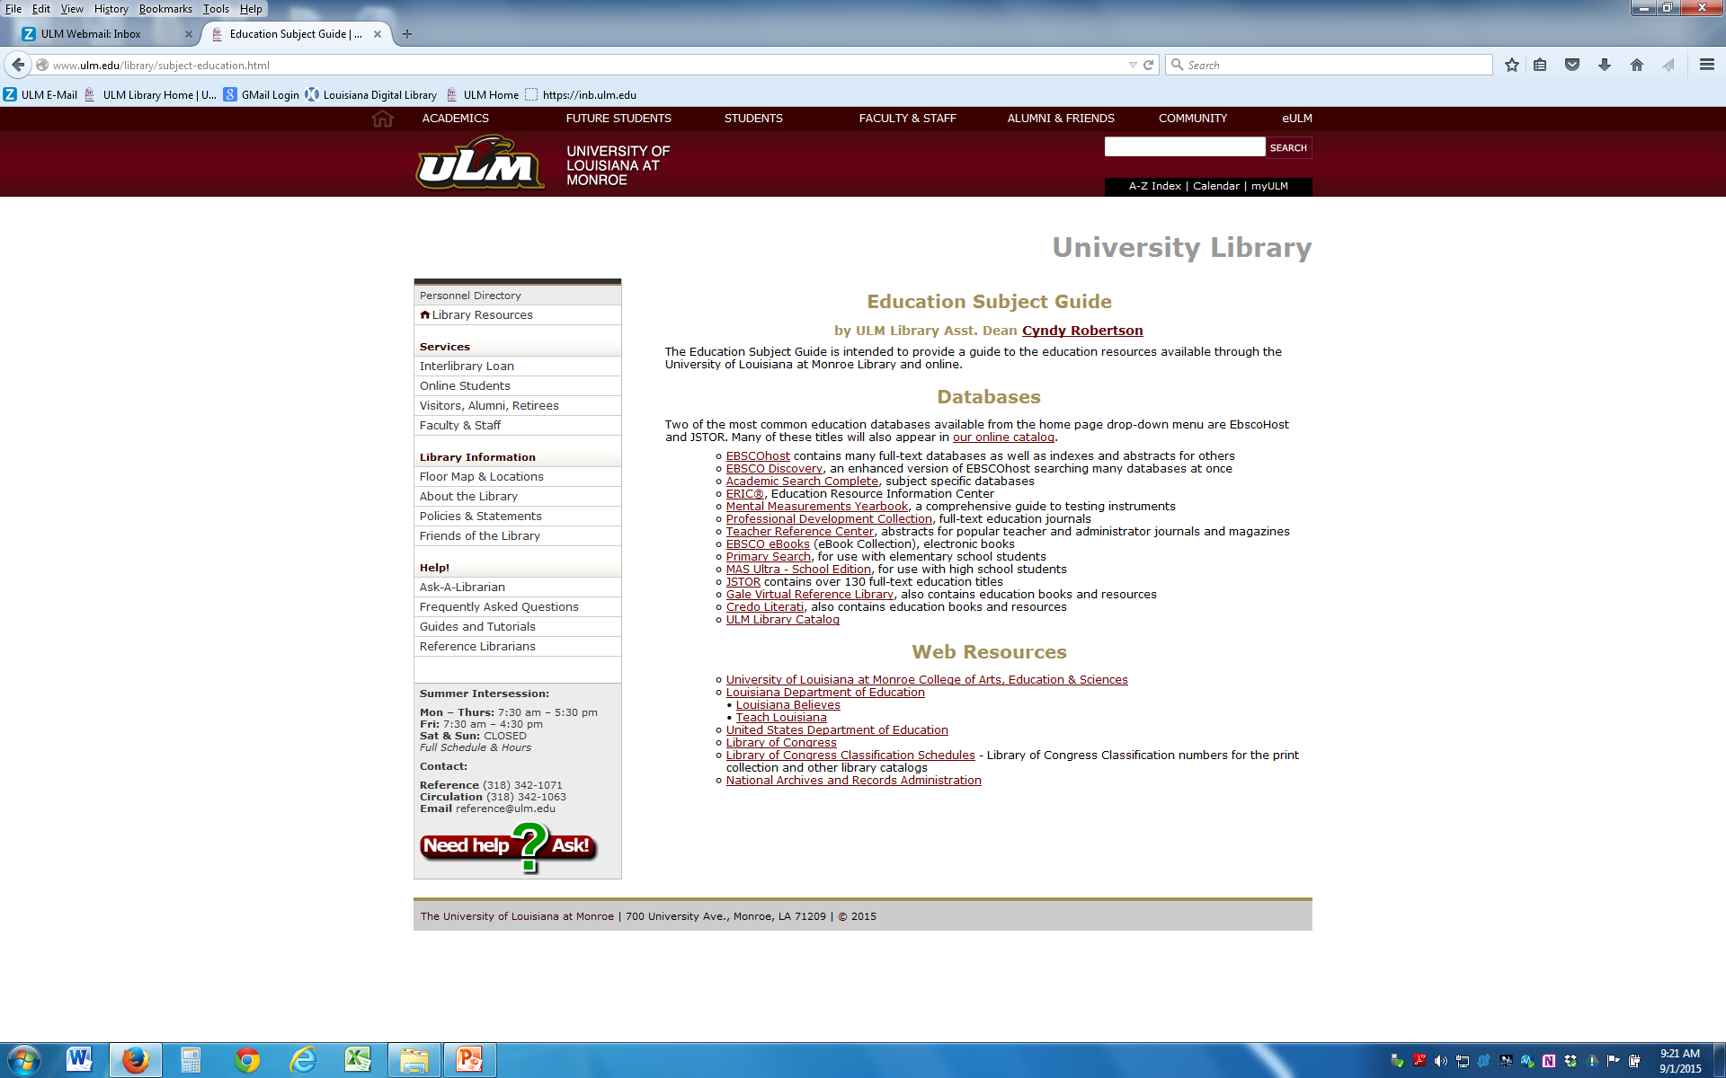
Notes:
This information is available on the web page.

Slide 22
Cyndy Robertson
ULM Library
342-1054
crobertson@ulm.edu
Notes:
Please contact me if you have questions.

