Slide 1
OCCUPATIONAL HEARING LOSS
AND
NOISE EXPOSURE
Notes:
Header: University of Louisiana @ Monroe academic emblem

Slide 2
Acknowledgement
United States Department of Labor
Occupational Safety of Health Administration (OSHA)
Susan Harwood Training Grant
SH-05151-SH9
This material was produced under a grant (SH-05151-SH9) from the occupational Safety and Health Administration, U.S. Department of Labor. It does not necessarily reflect the views or policies of the U.S. Department of Labor, nor does its mention of any trade names, commercial products, or organizations imply an endorsement by the U.S. Government.
Notes:
This presentation was produced by a grant (SH-0515-SH9) provided to University of Louisiana at Monroe, College of Pharmacy, School of Basic Pharmaceutical and Toxicological Sciences’ Undergraduate Toxicology program by the Susan Harwood Training Grant program (SHTG-FY-19-02). The Susan Harwood Training Grant program is sponsored by the United States Department of Labor, Occupational Safety and Health Administration.

Slide 3
Disclaimer
The materials provided in this presentation are for information and awareness purposes. In no instances and under no conditions should they be used as a reference for compliance with the OSHA Occupational Noise standard (29CFR 1910.95). The link to obtain a copy of the standard is provided below.
1910.95_OSHA_Occupational_Noise_Exposure
Notes:
The university of Louisiana at Monroe declares that the material presented herein are for informational purposes only. In no instances and under no conditions should they be used as a reference for compliance with the OSHA Occupational Noise Exposure Standard (29CFR1910.95). The Occupational Noise Standard can be found at: osha.gov/laws-regs/regulations/standardnumber/1910/1910.95

Slide 4
Overview
Introduction
Worker Rights under OSH Act
Sound and Noise
Noise Induced Hearing Loss
The Noise Standard
Hearing Conservation Program Elements
Hierarchy of Controls
Hearing Protection PPE
Notes:
The primary purpose of this presentations is the prevention of occupationally-related noise-induced hearing loss. Several related/support topics will be discussed, as needed, to better define the primary topic.

Slide 5
Worker Rights – OSH Act
Occupational Safety and Health Act (OSH Act):
Signed in to law December 29, 1970
Entitles workers to safe and healthful conditions
Provides workers with the right to:
Ask OSHA to inspect their workplace
Review employers’ records of work-related injuries and illnesses
Get copies of their medical records
Receive information and training about hazards and their prevention, using applicable OSHA standards.
Notes:
Workers are entitled to safe and healthful working conditions, these are conditions that do not pose a risk of serious or recognized safety and health hazards. The OSH Act provides workers with the right to ask OSHA to inspect their workplace without fear retaliation and/or discrimination; receive information and training about existing hazards, and methods used to control these hazards. Additionally, the OSH Act provides workers the right to ask for heath and safety information applicable to their workplace; including industrial hygiene survey results and other workplace hazard testing data, copies of OSHA standards that apply to their workplace, the opportunity to review work-related injury and illness records, and access to their medical records.

Slide 6
Worker Rights – OSH Act - continued
Formal complaint:
Workers may file a formal complaint with OSHA
Employers may not retaliate (take unfavorable personnel actions) against an employee for being a whistleblower.
For more information, please see:
OSHA Whistleblowers Protection Program
Whistleblower laws require that complaints be filed with OSHA within certain time limits following the alleged retaliation.
Notes:
Workers may file a complaint with OSHA if the employer retaliates by taking unfavorable personnel action against them because workers are engaged in protected activity relating to workplace safety or health, asbestos in schools, cargo containers, airline, commercial motor carrier, consumer product, environmental, financial reform, food safety, health insurance reform, nuclear, pipeline, public transportation agency, railroad, maritime, motor vehicle safety, and securities laws.
Employers cannot punish workers in any way for:
Reporting an injury or illness;
Complaining to your employer, union, OSHA or other agencies about safety and health problems;
Filing safety and health grievances;
Participating in safety and health committees; or
Participating in OSHA inspections and other OSHA-related activities.
If it is believed that the employer retaliated against the worker because of exercising his/her legal rights as an employee, the worker must contact OSHA as soon as possible. the complaints must be filed within the legal time limits. An employee can file a complaint with OSHA by visiting or calling the local OSHA office or sending a written complaint to the closest OSHA regional or area office. Written complaints may be filed by facsimile, electronic communication, hand delivery during business hours, U.S. mail (confirmation services recommended), or other third-party commercial carrier.
If a worker is fired, demoted, transferred or discriminated against in any way for using his/her rights under the law, he/she must file a complaint with OSHA within 30 days for OSHA to take the case.

Slide 7
Perception of Occupational Noise Exposure and Hearing Loss
Occupational Noise Perception:
Just part of heavy industry
No way to eliminate it in the work place
Workers will always be exposed to noise
Perception of work-related hearing loss:
Just part of the job
If you work in industry – you will loose your hearing
Notes:
There are many perceptions regarding occupational noise exposure and work-related hearing loss. The common theme is that “industry is noisy and there is nothing that can be done about it” and “hearing loss is just part of life if you work in industry”.
These perceptions are not entirely true!
Yes, industrial process equipment typically produces loud sounds. However, in many cases, engineering controls can be implemented to reduce the impact of these sounds. Engineering controls are mechanical solutions used to reduce employees’ potential exposure to an occupational hazard. Regarding noise exposures, engineering controls may include isolating or inclosing high noise equipment, or dampening noise producing vibrations to reduce nose production.
Yes, history and data shows that hearing loss is a common occupational illness. However, even in situations where adequate noise controls are not feasible, work-related hearing loss does not have to be part of working in industry and industrial workers can retire from a life time of work without work-related hearing loss that exceeds normal, age-induced hearing loss.

Slide 8
Impact of Occupational Noise Exposure
Safety considerations
Lost quality of life
Lost employment opportunities
Notes:
How does occupational noise exposure and hearing loss impact workers’ lives?
Safety concerns: Loud work environments can have a negative effect on the overall safety of the workplace. In addition to the potential for hearing loss, workplace noise can reduce the efficiency of verbal communications, warning alarms, and the workers’ ability to hear other activities in the workplace, such as motor vehicle traffic.
Lost quality of life: Chronic exposure to loud noise does not directly result in loss of life. However, the loss of hearing can have a very dramatic effect on the quality of life. The inability to communicate with family and friends; enjoy music, television, or movies; appreciate the sounds of nature in a wilderness setting or even the yard can all take a toll on an individual’s wellbeing.
Lost employment opportunities: The Americans with Disabilities Act protects persons with disabilities, including hearing loss, from discrimination. However, hearing loss may impact an individual’s ability to efficiently execute the requirements of a job, and impact hiring or advancement opportunities.

Slide 9
Prevalence of Occupational Noise Exposure and Hearing Loss
3rd most common chronic physical condition amongst U.S. adults
Approximately 22 million workers exposed to hazardous levels of noise each year
Approximately 12% of U.S. working population has hearing difficulties
Approximately 24% of hearing difficulty among U.S. working population caused by occupational noise
NOTE: Data from NIOSH website
Notes:
Millions of American workers are exposed to hazardous levels of noise each year. Many of these workers will develop some level of a noise-induced adverse health effect.
The data presented in the slide was obtained from the National Institute for Occupational Safety and Health (NIOSH) website.

Slide 10
Hearing Loss vs Other Occupational Illnesses U.S. Bureau of Labor Statistics Data 2014 - 2018
Year | Hearing Loss | Skin Diseases | Respiratory Conditions | Poisonings | All Other Illnesses | Total Cases
2018 | 11,400 (9.0) | 3,900 (3.1) | 1,600 (1.2) | 100 (0.1) | 18,100 (14.3) | 35,000 (27.7)
2017 | 10,500 (8.4) | 3,600 (2.9) | 1,100 (0.9) | 200 (0.1) | 18,900 (15.2) | 34,300 (27.6)
2016 | 12,100 (9.7) | 3,600 (2.9) | 1,500 (1.2) | 200 (0.1) | 21,900 (17.6) | 39,200 (31.5)
2015 | 13,500 (10.9) | 4,200 (3.4) | 1,700 (1.3) | 200 (0.2) | 21,200 (17.1) | 40,800 (32.9)
2014 | 13,700 (11.2) | 4,400 (3.6) | 1,500 (1.2) | 200 (0.1) | 23,000 (18.9) | 42,000 (35.0)
Notes:
The U.S Department of Labor’s Bureau of Labor Statistic (BLS) uses occupational accident and injury data submitted by U.S. industries on the OSHA 300 log to develop data sets and study trends. The data presented in the table represents nonfatal occupational illnesses from the manufacturing sector. The presented data was obtained from the U.S. Bureau of Labor Statistics, Table SNR07. At the time of the development of this presentation, 2018 data was the most recent data available.
For each illness classification, the number of cases (nearest 100) and incident rate (in brackets) is presented.
The data provided is the incident rate (IR) for each classification of nonfatal occupational illness for the given year. The incidence rates represent the number of illnesses per 10,000 full-time equivalent workers and were calculated as: (N/EH) x 20,000,000., where N = number of illnesses.
As indicated in the table, occupational hearing loss is the most common, nonfatal occupational illness group identified. Only the conglomerate of “all others” exceeded hearing loss.

Slide 11
Sound and Noise
What is sound?
The impression made when an atmospheric pressure wave reaches a responsive ear
What is noise?
Classic definition:
An unwanted or unpleasant sound
Very subjective definition
What sounds can cause hearing loss?
Any sounds that have certain characteristics may cause hearing loss
Notes:
Sound: The impression produced when an atmospheric pressure wave (variation), having certain characteristics reaches a responsive ear. It has physical characteristics that are interpreted by the individual.
Noise: Any unwanted or unpleasant sound, typically 10 decibels above ambient or background sounds. The determination of a sound being noise is very subjective! A sound found to be noise by one individual, may be found to be a pleasant sound by another. This is commonly encountered when discussing different styles of music with a group of individuals. However, industrial machinery operators often find a melodic quality to the sounds of their machines, and may find the sound of a smoothly operating machine pleasant.
Whether or not a sound is considered noise or pleasant has absolutely no bearing on its ability to cause a “noise”-induced hearing loss! The ability of a given sound to cause hearing loss is based on several factors that have nothing to do with whether the individual finds the sound pleasant or a noise.

Slide 12
Hazardous Sound (Noise)
Several factors determine the potential hazard of a given sound.
Important physical properties of sound:
Loudness:
Louder sounds have greater potential hazard
Frequency:
Higher frequency sounds are generally considered more harmful
Notes:
Loudness: The loudness of sound is commonly discussed in units of decibels (dB). A sound at 100 dB is inherently more hazardous than a sound at 90 dB.
Frequency: Frequency is commonly discussed in terms of hertz (Hz) or as a sound’s pitch or tone (high pitch = high frequency). Research has determined that sounds of higher frequency are more hazardous to the human hearing system than sounds of low frequency. Therefore, a 95 dB sound that is 4,000 Hz is inherently more hazardous than a 95 dB sound that is 500 Hz.
Hazard Determination: Loudness and frequency are only two of the factors used to determine the significance of a potential noise hazard in the workplace. Other factors, such as exposure time and frequency of exposures also play very important roles in the effects of workplace noise on the workers.

Slide 13
Examples of Common Noises
Equipment or Area | Loudness (Decibels - dBA)
Pneumatic chipper, needle gun, etc., near operators ear | 110 – 120
Chainsaw, near user’s ear | 105 – 110
Impact wrench, near user’s ear | 100 – 105
Kitchen blender, at approximately 3 feet | 90 – 95
Table saw, near user’s ear | 90 – 95
Lawn mower, near operators ear | 85 – 95
Vacuum cleaner, at approximately 10 feet | 75 – 80
Normal speaking voice, at approximately 3 feet | 60 – 70
Quiet control room or office | 45 – 60
Bedroom, quiet, at night | 30 – 40
Notes:
Sounds are a ubiquitous part of our lives, Some are noise and some are desirable; some are loud and some are quiet; some are occupational and some are not. Sound levels of common occupational and non-occupational sources are presented in table, these sound levels should only be considered as estimates and not absolutes for the equipment or environment. The sound levels given are only estimates, numerous factors, such as specific model of equipment, age of equipment, and distance from the source, etc. may play a role in the loudness of an individual source.

Slide 14
Noise-Induced Hearing Loss
Definition:
Noise-Induced hearing loss (NIHL) is a type of sensory neural hearing loss caused by repeated exposure to sounds that meet certain characteristics
NIHL is a repetitive trauma disorder:
Repeated trauma to the inner ear caused by exposure to loud sounds may result in NIHL
Notes:
Repeated exposure to sounds that meet certain characteristics can result in a noise-induced hearing loss.
Noise-Induced Hearing Loss: NIHL is a type of sensory-neural hearing loss. Sensory-neural hearing loss is a loss of hearing, partially or completely. It is caused by damage to the neurological component of the auditory system located in the inner ear. Sensory-neural hearing loss is a permanent type of hearing loss.
Repetitive Trauma Disorders: Repetitive trauma disorders are adverse health effects that develop over time, due to repeated trauma. NIHL generally occurs throughout a worker’s career. It is a gradual hearing loss that may not be identified until it begins to affect quality of life elements, such as the ability to hear/understand verbal communications. Later in the presentation, the importance of annual audiograms and early recognition of NIHL will be discussed.
As discussed in previous slides, important sound characteristics include loudness and frequency – loud, high frequency sounds are more damaging to the human auditory system. In cases where workers are exposed to extremely loud, high frequency sounds continually throughout the workday, day after day, the onset of noticeable NIHL may be much more rapid.
Generally, NIHL is discussed in terms of occupational noise exposure due to the loudness of sounds and frequency of exposure in many workplaces. However, repeated exposures to any loud sound, such as televisions, stereos, personal music devices, shop equipment (saws, planers, etc.), outdoor equipment (lawn mowers, chainsaws, firearms, etc.) can contribute to an individual’s NIHL.

Slide 15
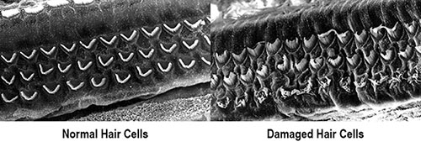
Example of Damaged Hair Cells
Inner ear: Area where mechanical energy is converted to electrical impulse
Cochlea: Structure where hair cells are located
Hair Cells: Structures whose movement creates electrical impulse for sounds
Image of normal and damaged hair cells
Note: Image obtained from CDC website
Notes:
Noise-Induced Hearing Loss is a result of damage to the neural component of the auditory system. More specifically, damage to the hair cells. The hair cells are located in a structure known as the Cochlea, the Cochlea is located in the inner ear. The hair cells are, in part, responsible for converting vibrations caused by sound into electrical impulses, which are sent to the brain for interpretation.
About the Image: The image on the left shows normal, healthy, fully intact hair cells. The image on the right shows hair cells that have been injured by damaging noise (sound) exposure. These injured hair cells will never recover from this damage. Note how the damaged hair cells are bent and tussled, whereas the normal hair cells are straight and organized.
Note: The image was obtained from the CDC’s website: https://www.cdc.gov/nceh/hearing_loss/how_does_loud_noise_cause_hearing_loss.html

Slide 16
Hazard Exposure Time
Exposure time:
The amount time the worker is exposed to the hazard
How much time per day (shift)
Frequency of exposure:
How often does the exposure occur?
Daily, weekly, monthly
Time-Weighted-Average
Notes:
A determining factor for potential health hazards is the exposure time or dose. Regarding all health hazards – the greater the dose, - the great the potential for adverse health effects to occur.
When evaluating “noise” exposure, the exposure time is as important as the loudness of the sound. Since NIHL is a repetitive trauma illness, it is important to understand how frequently the trauma occurs. Is it a few minutes or hours per shift, or constant throughout the shift? Does it occur daily or only one day a week? Is it a constant, always present part of the job or is it something less? The answers to these questions are important in determining the risk of NIHL for an individual worker or a group of workers.
Time-Weighted-Average: When discussing exposures to occupational hazards, the common terminology used is Time-Weighted-Average (TWA). This is an averaged workplace exposure, typically discussed in terms of an 8-hour TWA. Workers do not receive a constant or level noise exposure throughout the workday; it will vary throughout the day as the employees perform their jobs. An employee’s exposure may change by a decibel or more with minor movements around their work station, and may drop by 40 dB or more when they enter a control room, break room, or other “quiet” area. All of these different exposures are considered when determining the worker’s 8-hr TWA.
The OSHA noise Permissible Exposure Limit and Action Level are based on 8-hr TWAs.

Slide 17
OSHA’s Noise Standard
29 CFR 1910.95 – Occupational Noise Exposure
Purpose:
To protect workers from the effects of long-term “noise” exposure.
Two major parts:
Permissible exposure limit (PEL)
Hearing conservation program
Action Level
Notes:
OSHA’s Noise Standard: The OSHA noise standard (29 CFR 1910.95 – Occupational Noise Exposure) is one of the early OSHA standards, first promulgated in 1974. Its purpose is to protect workers from the effects of chronic exposure to noise by establishing a set of rules that employers must follow. Two major parts of the noise standard are the permissible exposure limit and the hearing conservation portions.
Permissible Exposure Limit: The PEL is the maximum allowable sound level (dose) that a worker may be exposed to without the implementation of noise reduction controls or use of hearing protection. This topic will be discussed more in upcoming slides.
Hearing Conservation Program: The Hearing Conservation Program includes a set of medical surveillance and training requirements that must be administered when a worker’s 8-hr TWA hits the action level of 85 dBA. This topic will be discussed more in upcoming slides.

Slide 18
Noise Permissible Exposure Limit
Permissible Exposure Limit:
8-hr Time-Weighted-Average (TWA)
90 dBA
Allowable exposure time is decreased as exposure level increases above 90 dBA; for instance:
95 dBA maximum duration is 4 hours
Peak or Impulse Noise:
Exposure should not exceed 140 dBA
Notes:
Permissible Exposure Limit (PEL): OSHA has established an 8-hr Time-Weighted-Average of 90 dBA as the Permissible Exposure Limit (PEL) for noise. As the sound level increases, the permissible exposure time decreases, as portrayed in Table G-16 of 1910.95 (presented on the next slide). If a worker’s exposure meets or exceeds the PEL, the employer must institute feasible administrative or engineering controls to reduce the workers’ exposure to levels below the PEL. During the interim between identifying the hazard and implementing controls, or if controls are not successful in reducing the worker’s exposure to acceptable levels, personal protection must be worn.
“dBA” refers to decibels (dB) measured on the “A” weighting network. The “A” weighting network discriminates against low frequency sounds and attempts to approximate the human ear’s response to sounds. When conducting noise surveys for OSHA compliance purposes, industrial hygienists set their monitoring equipment to use the “A” weighting network.

Slide 19
OSHA Noise Standard Table G-16 – Permissible Noise Exposures
Exposure Duration per Day in Hours | Sound Level in dBA with Slow Response
8 | 90
6 | 92
4 | 95
3 | 97
2 | 100
1 ½ | 102
1 | 105
½ | 110
¼ or less | 115
Notes:
OSHA Table G-16: This table depicts the allowable exposure time (in hours – left column) of unprotected exposure to various sound pressure levels (right column). Note: as the sound pressure increases, the allowable exposure time decreases.

Slide 20
Hearing Conservation Program
Mandated by 1910.95 when:
Worker 8-hr TWA noise exposure meets or exceeds 85 dBA
Components:
Exposure monitoring
Audiometric testing program
Hearing Protectors
Training program
Recordkeeping
Notes:
29 CFR 1910.95(C) – Hearing Conservation Program: Requires that employers administer a continuing, effective Hearing Conservation program whenever worker 8-hr TWA exposures meet or exceed 85 dBA.
Purpose: The purpose of this program is to identify the early onset of Noise-Induced Hearing Loss and initiate corrective actions before hearing losses become significant.
Program Components: Required components of a hearing conservation program include: Exposure monitoring, Audiometric testing program, Hearing protectors, Training program, and Recordkeeping. A quality hearing conservation program should thoroughly cover each of these topics. The standard describes how each component must be completed.

Slide 21
Exposure Monitoring
When?
When workplace conditions indicate that an employee’s exposure may meet or exceed an 8-hr TWA of 85 dBA, employers must develop and implement a monitoring program.
By Whom?
Industrial hygienist
Occupational health professionals
Notes:
Exposure Monitoring: Exposure monitoring is a method of evaluating a potential occupational hazard’s impact on the workers. It is typically conducted by an industrial hygienist. Industrial hygienists (IH’s) are occupational health professionals that are uniquely qualified to recognize and evaluate workplace environments for a variety of potential workplace hazards. IH’s are capable of developing and implementing a monitoring strategy to thoroughly evaluate workers’ exposure to workplace noise.
When: Employers are obligated to know if any of their workers exceed the PEL or meet the minimum requirements for inclusion in a hearing conservation program. Exposure monitoring should be conducted when conditions indicate workers may meet or exceed to PEL or Action Level. These conditions may include loud manufacturing equipment or tools, or difficult verbal communications in work area due to elevated ambient sound.
.

Slide 22
Exposure Monitoring - Continued
How Often?
When exposures may change due to modifications or changes in:
Production
Process
Equipment
Frequently enough to know:
If additional workers should be included
If certain employees can be removed from the program
If the program should be updated
Notes:
Frequency of Exposure Monitoring: Exposure monitoring should be conducted often enough to ensure worker exposures are fully understood. Generally, monitoring should be repeated whenever changes in the production process or equipment, or employee work activities increase noise levels or exposure time to the extent that additional employees may be exposed at or above the action level, the protection provided by hearing protectors may be inadequate, or other controls should be implemented.
A comprehensive method of evaluating worker exposures to noise is of the utmost importance to fully understand what is needed in a particular workplace to ensure the best approach to protecting the employees’ hearing.

Slide 23
Audiometric Testing Program
What is “Audiometric Testing”:
A medical testing procedure that evaluates an individual’s hearing sensitivity
Purpose:
Evaluate workers’ hearing sensitivity and identify those workers that may be experiencing a hearing “Threshold Shift”
Notes:
Audiometric (hearing) Testing program: Audiometric testing is a mandatory component of the Hearing Conservation standard. All workers that meet or exceed the action level must be included in this program, however, many employers elect to include all of their employees in the program.
What is it? Audiometric testing is a procedure commonly used to evaluate an individual’s hearing sensitivity. This is accomplished by exposing each ear, separately, to test sounds that are at known frequencies and loudness. The individual indicates, typically by pushing a button, when they hear each sound. The testing results are presented in an audiogram ( a graph of the data) and compared to an acceptable “standard”, based on the individual’s age and sex.
Purpose: Audiometric testing is used to evaluate changes in workers’ hearing sensitivity over numerous sound frequencies. Workers are given an initial or base-line audiogram when they are enrolled in the employer’s program. They then receive annual audiograms throughout the time they remain covered by the hearing conservation program. Successive audiograms are compared to the worker’s baseline audiogram to determine if a change in hearing sensitivity (threshold shift) has occurred. A threshold shift may be a sign of noise-induced hearing loss. However, the shift may be caused by other reasons, and therefore, workers experiencing shifts of certain characteristics should be evaluated by a medical professional.

Slide 24
Hearing Conservation Training Program Requirements
Who?
All workers that meet the requirements for inclusion in the hearing conservation program must be included in the training program
When:
Initially
Annually
Notes:
Training Program: A training program is a mandatory component of the Hearing Conservation standard. All workers meeting or exceeding the action level must be included in this program, however, many employers elect to include all of their employees in the program.
Initial Training: Once it is determined workers meet the requirements for inclusion in the hearing conservation program, they must be trained.
Annual Training: All employees included in the hearing conservation program must have updated training annually.

Slide 25
Hearing Conservation Training Program Requirements (Continued)
Topics?
Effects of noise on hearing
Hearing protection:
Advantages, disadvantages, and attenuation of various types
Instruction for selection, fitting, use, and care of various types
Audiometric testing:
Purpose
Explanation of procedure
Notes:
Training Program Topics: At a minimum, the training program must include the following topics: 1) the effects of noise on hearing, 2) the purpose of hearing protectors; advantages, disadvantages, and attenuation of various types; instruction of selection, fitting, use, and care of various types, and 3) purpose of audiometric testing, and an explanation of the test procedure.
Additional information pertinent to a specific workplace or employee group may be added as needed.

Slide 26
Noise Exposure Controls
Hierarchy of hazard control:
Elimination of hazard:
The hazard is completely removed from the workplace
Control of the hazard:
The hazard is controlled or managed to levels not considered to be hazardous
Protect against the hazard:
The hazard exists at hazardous levels in the workplace and personal protective devises are used to protect the employee
Notes:
The hierarchy of hazard control is a philosophy used to evaluate and select methods of protecting employees from occupational hazards – in this case noise.
When workers’ noise exposures exceed an 8-TWA of 90 dBA (or exceed exposure levels presented in 1910.95 – Table G-16) feasible administrative or engineering controls shall be utilized. If these controls fail to reduce worker exposures to under the 8-hr TWA of 90 dBA or below levels listed in Table G-16, personal protective equipment shall be provided and used to attenuate workers exposures.
Elimination of hazard: The first choice or most desirable option is to eliminate the hazard – if a hazard is completely eliminated from the workplace, no additional concerns or resources must be directed towards the hazard. Due to the nature and relationship of noise and industrial equipment/tools, the complete elimination of a noise hazard is often difficult to achieve.
Control of hazard: The second choice is to control the hazard – in this case, the hazard is controlled to levels not considered to be harmful to employees. This may be accomplished through the implementation of engineering controls, which reduce the loudness of noise being created by equipment or isolate the noise source (or workers) to reduce or prevent excessive noise in the workplace. Another option is administrative controls. A common administrative control is crew rotations – rotating workers for areas of higher exposure to areas of lower exposure throughout the shift.
Protect against hazard: The last choice is the use of personal protection – in this case, the utilization of hearing protectors to protect the workers from noise hazards. PPE is deemed the “last choice” because it is reliant on the proper PPE being selected and it being properly and consistently used by the workers. The employer is obligated to provide workers with the proper personal protective equipment (PPE) and provide training regarding selection, use, fitting, care and maintenance. Additionally, the worker is obligated to follow workplace rules and properly wear PPE.

Slide 27
Hearing Protection Devices
Many types of protectors are available
Offer different levels of protection
Proper selection is required for maximum protection
Selection criteria:
Level of noise exposure
Noise Reduction Rating
Type of work being performed
Environmental conditions
Employee comfort
Notes:
A very wide variety of hearing protectors are available on the market, however, all do not provide the same level of protection for all workplaces and all employees. The proper protector must be selected and properly worn to provide the maximum level of protection for the employee. Employers must thoroughly understand their workers’ exposures to ensure a proper selection of hearing protectors is made available to the workers.
Criteria that should be considered when selecting hearing protectors for a given work place include:
Noise level in the environment and required Noise Reduction rating: Hearing protectors must meet minimum protection requirements if they are to be offered to workers.
Type of work being performed: The type of work and frequency of donning (putting on) hearing protectors should be considered during the selection process. For instance, in cases where employees have constant exposure and protectors are worn for long periods of time, perhaps a formable-foam plug design would be a good design. However, if workers need to put hearing protectors on and take off (doffing) frequently during the shift, for hygiene purposes, perhaps pre-molded plugs with a stem or muffs are a better option. In some work environments a non-corded plug may be a better option than a plug with a cord.
Environmental conditions: Many workers find muffs hot and uncomfortable in hot/humid environments, perhaps a plug is a better option in these environments
Employee comfort: Worker comfort is very important for proper and consistent use of hearing protectors. Workers may never enjoy wearing hearing protectors, however, the less irritating they are, the more likely employees are to consistently and properly wear the protector. All workers may have different comfort expectations, therefore, a selection of appropriate hearing protectors should be made available.
Donning/Doffing: “Donning” and “doffing” are two terms commonly used in conjunction with wearing PPE. “Donning” means to “put on”, and “doffing” means to take off, in the context of PPE usage.

Slide 28
Types of Hearing Protection Devices
Three basic types of hearing protectors
Ear muffs
Earplugs (inserted)
Canal caps (semi-aural earplugs)
Mode of operation:
Passive attenuation
Active attenuation
Active noise cancellation
Notes:
Types of hearing Protectors: There are three basic types of hearing protectors – ear muffs, earplugs, and canal caps. Each type has advantages and disadvantages that will make them better or worse options for a given workplace. There are numerous variations of each type of hearing protectors, these will be discussed in upcoming slides.
Mode of Operation: The “mode of operation” refers to how a hearing protector attenuates noise. A complete discussion is provided on the next slide.

Slide 29
Hearing Protector - Mode of Operation
Three Modes of Operation
Passive attenuation:
Earplugs, canal caps, or muffs
Noise is attenuated by the construction materials, blocking or partitioning auditory canal, etc.
Active attenuation:
Earmuffs
An electronic component with volume control allows the user to determine how much sound reaches the ear
Active noise reduction:
Earplugs and muffs
Electronic component creates an inverse sound wave that “cancels” out the noise wave
Notes:
Hearing protectors may protect the user’s hearing by several different modes of operation.
Passive attenuation: The most basic and most commonly used type of hearing protectors are passively attenuated. The construction material of the protector is used to absorb (attenuate) the sound pressure and/or isolate the ear from the noise source. The noise reduction rating of these protectors is based on the construction materials and design. Proper Noise Reduction Rating (NRR) and fitting are crucial for maximum protection to be achieved in a given environment. The Noise Reduction Rating refers to the level of sound attenuation provided by a particular model of hearing protector. This topic will be discussed in more detail in an upcoming slide.
Active attenuation: This option is most commonly used with earmuffs in noisy settings where a great deal of verbal communication in required, such as, rail yards, loading docks, airfields, etc. Active attenuation earmuffs are equipped with an electronic component and microphone, allowing the user to communicate via the microphone while adjusting the sound level inside the muff.
Active noise reduction: Active (or electronic) noise cancellation technology is used in many types of applications, including hearing protection, as well as methods to reduce fan noise in ventilation system and road noise in automobiles. Active sound cancellation is available in earplugs and earmuffs for both, controlling noise exposure for health and improving music enjoyment by removing background sounds. Active sound cancellation uses a microphone, processor, and speakers to evaluate noise (or background sound) characteristics and produce a a duplicate sound wave that is 180° out of phase (or inverse sound) which cancels the target sound.

Slide 30
Attenuation of Noise
Purpose of hearing protectors:
Attenuation of sound pressure
Reduce but not eliminate workplace sounds
Protect workers’ hearing
Reduce sound pressure to lessen impact on auditory system
Notes:
Attenuation means to reduce force or energy. Hearing protectors are not used to or intended to block out all sound – completely removing all sounds from the workplace would create its own set of potential safety hazards.
Hearing protectors attenuate or reduce the volume (level) of sound reaching the worker’s hearing system. In some cases, hearing protectors are designed to be more efficient attenuating frequencies above the “speech-range” frequencies, this enhances the ability to communicate in noisy environments.

Slide 31
Effectiveness of a Hearing Protector
Noise Reduction Rating (NRR):
Noise attenuation value
Field Attenuation:
OSHA
TWA (dBA) – (NRR-7) = Estimated Exposure (dBA)
OSHA Recommendation:
TWA (dBA) – [(NRR-7) x 50%] = Estimated Exposure (dBA)
Fit Testing
Procedure that measured the “fit” of a hearing protector
Notes:
Noise Reduction Rating: The NRR is the amount of noise reduction, in dB, that a given hearing protector can provide in a laboratory setting, under specific conditions.
Field Attenuation: The NRR achieved for a given hearing protector in the laboratory environment is not possible to achieve in the workplace. Factors such as improper fitting, variations in workers’ ear canal shape and size, and head movements affect the fitting of a hearing protector and the amount of sound that reaches the eardrum. Therefore, OSHA requires that a protector’s NRR be adjusted or field attenuated (29 CFR 1910.95(j)(2)). The slide and discussion uses dBA units for the ambient sound level, OSHA offers additional equations if the ambient sound level is in dBC units. Also, there is an additional equation for duel hearing protector use.
Note on dBC: dBC refers to decibels (dB) measured on the “C” weighting network. The “C” weighting network discriminates slightly against very low frequency sounds and attempts to approximate the human ear’s response to sound levels above 85 dB. The “C” weighting network is not currently in common use by industrial hygienists,
OSHA Field Attenuation equation: TWA (dBA) – (NRR-7) = Estimated exposure (dBA)
Where: TWA (dBA): The measured sound level in the environment where the protector is intended to be worn
NRR: The manufacturer provided noise reduction rating for the hearing protector
“7”: OSHA’s reduction factor, a constant
Estimated exposure (dBA): Is the estimated sound level (A-network) that will reach the ear drum
Example: An ear plug with a NRR of 25 dBA is being used in a workplace with an ambient noise level of 94 dBA (TWA),
Standard Equation: 94 dBA – (25 dBA – 7) = 76 dBA; So, if the plug is inserted and fits properly, it will reduce the sound to 76 dBA in the users ear.
50% safety factor: OSHA “strongly” recommends the use of a 50% safety factor when calculating the field attenuation factor for a hearing protector. The safety factor is recommended to account for inconsistencies with the donning and fitting of a hearing protector. The following example utilizes the same scenario as above but utilizes the 50% safety factor.
Using the 50% safety factor: 94 dBA – [(25 dBA – 7) x 50%] = 85 dBA; By implementing the safety factor, the estimated noise reduction offered by the plug is only 9 dBA, which results in an estimated sound level of 85 dBA reaching the ear.
Fit Testing: Some hearing protection manufacturers make equipment to measure the effectiveness of ear plugs. This procedure easily measures the effectiveness of a specific plug used in in an individual. This procedure is not required by OSHA regulations.

Slide 32
Earmuffs
Devices that isolate the auditory system from noise by enclosing the entire external ear (pinna)
Major parts:
Hard (plastic) cups that cover the ears
Sound proofing foam lining
Sound proof perimeter cushion
Adjustable headband
Notes:
Earmuffs are common hearing protector devices that enclose the entire external ear. The primary parts regarding hearing protection are the cups that cover the ears. These are these are generally constructed of a hard, durable plastic outer shell and are lined with sound dampening materials. The perimeter of the muff is covered by a cushioning seal, filled with foam or liquid, that forms a seal with the head to prevent sound waves from entering the ear. The right and left muffs are attached by an adjustable headband.

Slide 33
Earmuffs Advantages and Disadvantages
Advantages
Disadvantages
Range of NRRs available
More protection at higher frequencies than earplugs
Reusable
Durable
Long lasting
Hard hat mountable
One size fits most
Active or passive noise attenuation
Higher cost per unit
Safety glasses interfere with fit and seal
Heavy/uncomfortable
Especially in hot environments
Must be cleaned between uses
Especially between different users
Must be inspected on a regular basis
Repairs may be required to maintain quality over long use life
Notes:
As with all hearing protectors, earmuffs have several advantages and disadvantages.
Advantages: Several advantages are presented in the slide. Of particular significance is the protection against high frequency sounds – they tend to offer better protection than most plugs. Additionally, muffs are designed to be durable and long lasting. They are available in passive or active noise attenuation and may be better suited for some work environments than earplugs.
Disadvantages: Muffs are not without disadvantages, they often cost more that earplugs; some users find them heavy/hot or generally uncomfortable to wear, especially in hot environments; they may not fit properly with safety glasses or respirators, and special hardhat attachments must be used in areas where hardhats are required. Since they are designed to be used repeatedly, over a long period of time, cleaning, inspection, and maintenance concerns must be addressed.

Slide 34
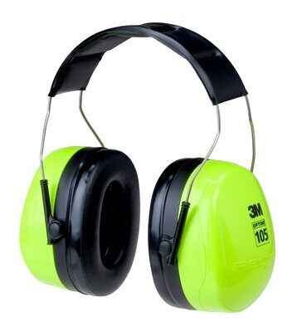
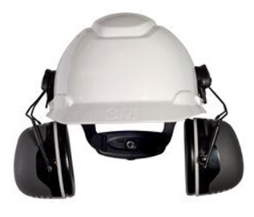
Examples of Earmuffs
Earmuffs;
NRR 27 dB
Earmuffs;
NRR 30 dB
Hardhat mounted earmuffs;
NRR 31 dB
Notes:
Examples of earmuffs.
Please note, these images are for example purposes only, and do constitute an endorsement of the products

Slide 35
Earplugs
Ear plugs attenuate the sound pressure waves as they descend down the auditor canal.
Sounds can typically be heard but at a much reduced loudness, allowing for communications and awareness of the workplace
Several classes of earplugs are available:
Formable foam
Pre-formed silicone
Custom-made
Available with active sound cancellation technology
Each class has advantages and disadvantages
Notes:
Earplugs function by attenuating sound pressure waves as they descend down the auditory canal towards the tympanic membrane (ear drum). The construction of earplugs does not eliminate all sounds but dampen (reduce the pressure of) sound waves as they pass through the plug’s material and/or chamber created by the plug. Workers need to be able to hear ambient sound, but not at a level that may cause permanent damage to the auditory system.
Several different classes of earplugs are available on the market, including: expandable foam, pre-formed silicone rubber, and custom-made.

Slide 36
Formable Foam Earplugs
Constructed of soft polyvinyl chloride or polyurethane memory foam
Commonly used throughout industry
Available in many sizes, shapes, and colors
Generally found comfortable to wear by most users
Notes:
Formable foam earplugs are commonly used throughout industry. They are constructed of a compressible foam for easy insertion, the foam then expands to fill the auditory canal.

Slide 37
Formable Foam Earplugs - Fitting
Earplug is rolled between the thumb and index finger to compress the plug
Compressed plug is fully inserted into the auditory canal
Plug will quickly expand to fill the auditory canal
Remove slowly to prevent suction in the auditory cannel that may damage eardrum
Notes:
Images, with instructions for proper donning is presented on the next slide.

Slide 38
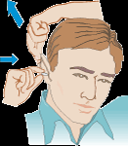
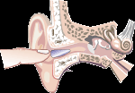
Images of Formable Earplug Insertion
Step 1
Step 2
Step 3
Roll and squeeze earplug to compress it into a thin, firm piece
Pull top of ear up and back to open/straighten ear canal, then completely inset compressed earplug
Hold earplug in place with finger as it expands, sounds should sound “muffled” with good fit
Notes:
Images presented in the slide depict the proper way to insert a formable foam earplug.
Step 1: The earplug must be compressed and rolled into a somewhat thin, firm cylinder to facilitate insertion into the auditory canal.
Step 2: Pulling the outer ear up and back will help straighten and open the auditory canal, this will improve the ease at which the earplug slides into the canal. Then insert the compressed earplug. It may take some practice to determine the best angle an individual must pull the ear to achieve the best earplug fit
Step 3: The inserted earplug should be held in place while it expands to prevent it from backing out of the ear canal. Once it fully expands the fit should be secure. Sounds should be muffled with a good fit.
Note: Images obtained from the NIOSH website

Slide 39
Formable Foam Earplugs Advantages and Disadvantages
Advantages
Disadvantages
Numerous NRRs available
Expands to fit most auditory canals
Generally considered more confortable than other types
Inexpensive and disposable
May or may not have cords
Small and light weight
No interference with hard hats or safety glasses
Handling of plugs may introduce foreign materials in to the auditory canal
Improper insertion reduces NRR value
Some individuals may find them uncomfortable
Notes:
Formable-foam earplugs are probably the most common type of earplug used in industry. They come in a variety of shapes, sizes, and colors to appeal to workers; cover a range of noise reduction ratings; are inexpensive and disposable; and most workers find them comfortable.

Slide 40
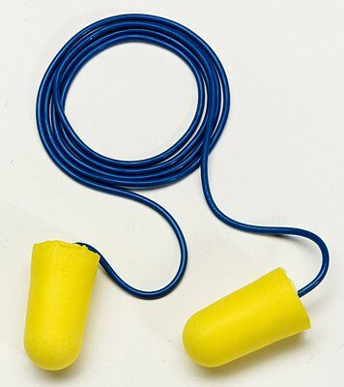
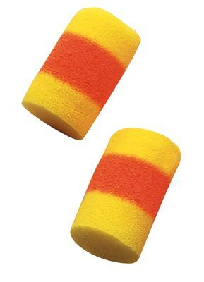
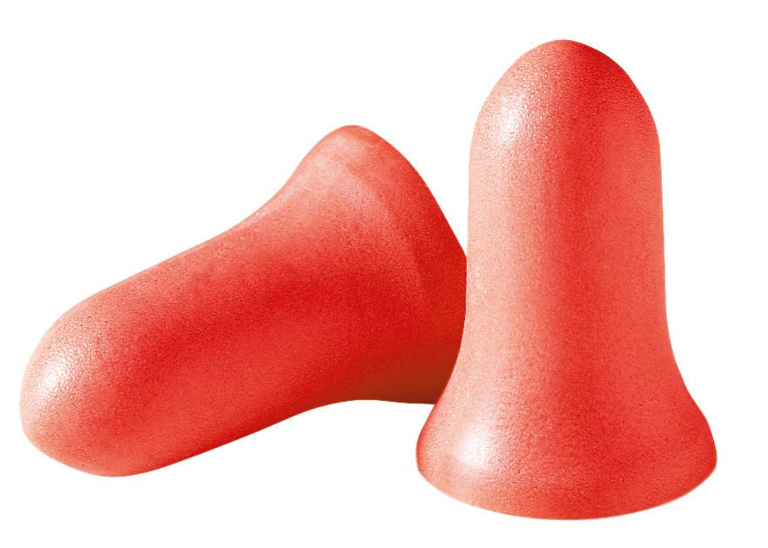
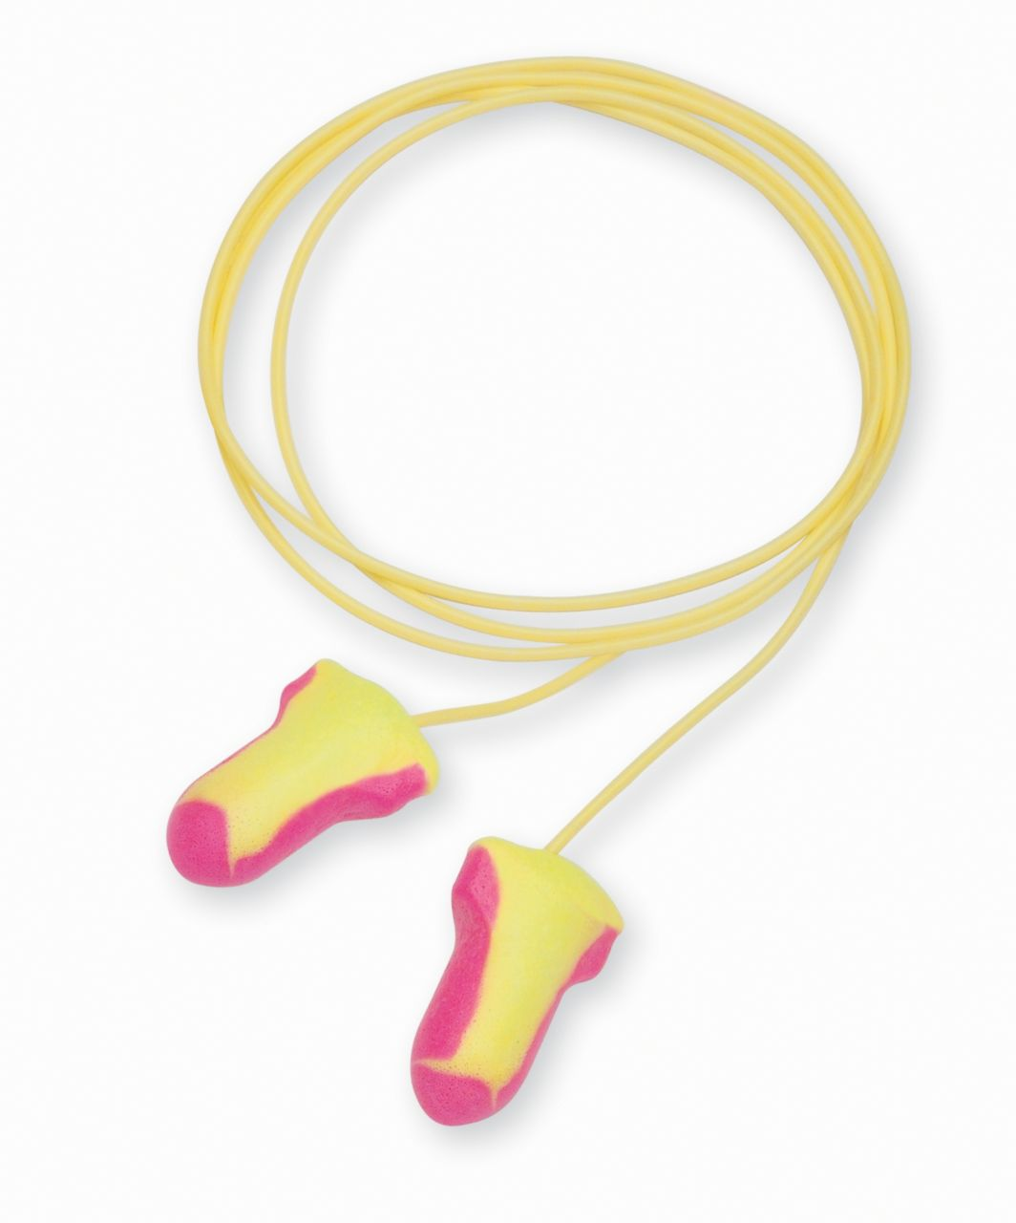
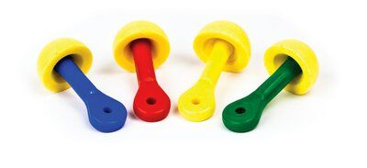
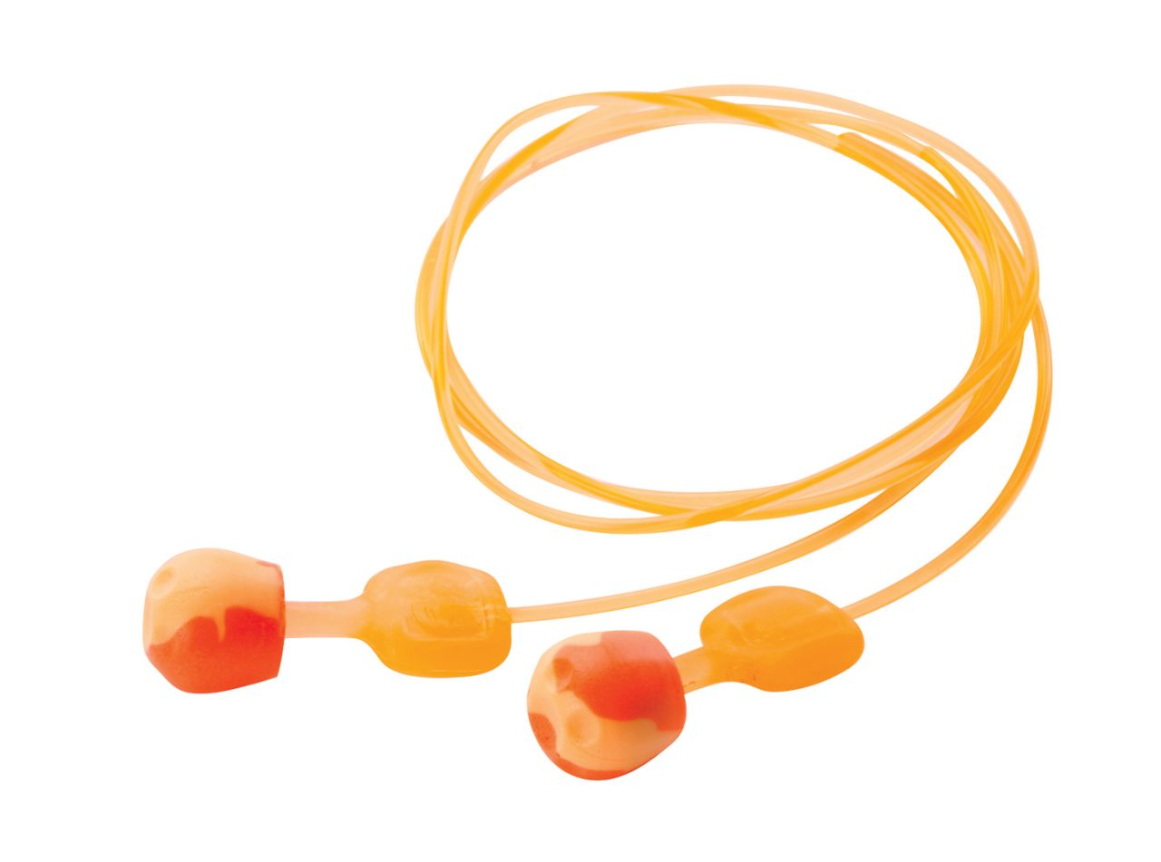
Examples of Formable Earplugs
Formable foam earplugs with cord;
NNR: 32 dB
Formable foam earplugs;
NNR: 33 dB
Formable foam earplugs;
NRR: 33 dB
Formable foam earplugs;
NRR: 32 dB
Foam pod plugs;
NNR: 25 dB
Foam pod earplugs; NRR: 28 dB
Notes:
Examples of foam earplugs.
Note: Earplugs with two colors (ends of matching color and different center color) are designed to show proper insertion, the center colored band should be completely in the ear canal and not visible when the plug is properly inserted.
Please note, these images are for example purposes only, and do constitute an endorsement of the products

Slide 41
Pre-Formed Earplugs
Constructed of soft, flexible, pre-shaped silicone/plastic or rubber
Variety of styles, colors, and sizes
Generally have 2 or 3 flanges which partition the auditory canal into isolated compartments by forming a seal with canal wall
Reusable, with proper care
Notes:
Pre-formed earplugs are as common as foam plugs in the workplace. Many employers include several types of pre-formed plugs in their selection of plugs for employees. Some employees prefer this style of plug, and in some environments it may be a more desirable choice of plug.

Slide 42
Pre-Formed Earplugs - Fitting
Use hand from opposite side of body to pull ear from the top
This may make insertion of earplug easier
Insert plug with a twisting or rotating movement
Remove slowly to prevent suction in the auditory cannel that may damage eardrum
Notes:
Fitting/inserting pre-formed earplugs is very similar to the insertion of foam earplugs (as presented in slide 36), the only difference is that the plug does not need to be compressed before insertion.

Slide 43
Pre-Formed Earplugs Advantages and Disadvantages
Advantages
Disadvantages
Have stem, which allows for clean insertion
Variety of shapes and sizes
Re-usable to a certain extent
Must be washed between uses
Inexpensive
Small and light weight
Easy to store
No interference with hard hats or safety glasses
Fitting concerns
May not fit both ears the same, an individual may need a different plug for right and left ear.
May be uncomfortable to some users

Slide 44
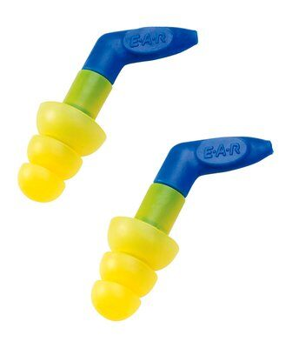
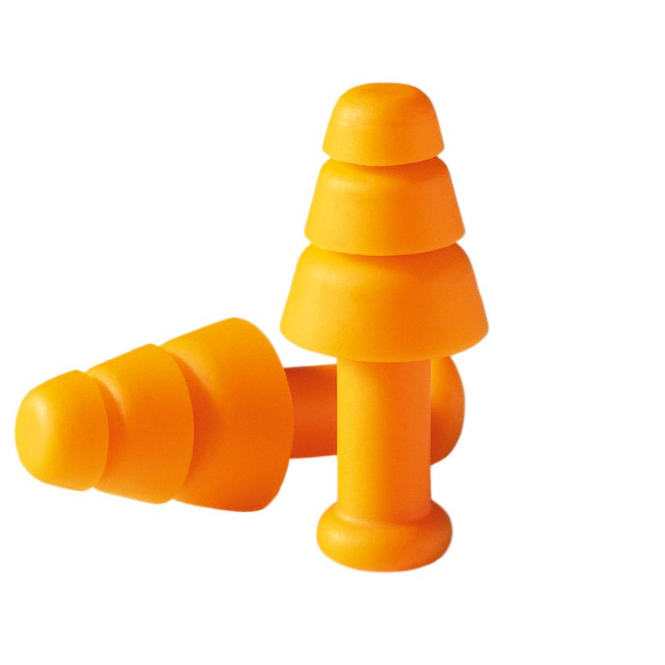
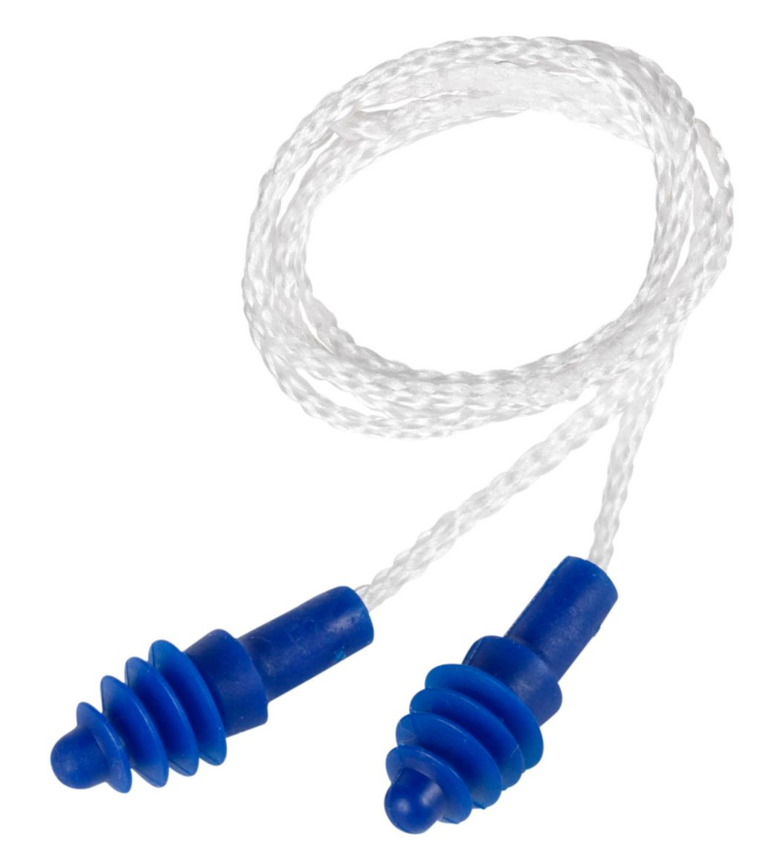
Examples of Pre-Formed Earplugs
Pre-formed earplugs;
NRR: 27 BA
Pre-formed earplugs;
NRR: 25 dB
Pre-formed earplugs;
NRR: 25 BA
Pre-formed earplugs;
NRR: 27 dB
Pre-formed earplugs;
NRR: 20 dB
Notes:
Examples of pre-formed earplugs.
Please note, these images are for example purposes only, and do constitute an endorsement of the products

Slide 45
Canal Caps (Semi-Aural Protectors)
Constructed with foam or silicone tips on a headband
Many models - tips do not insert deeply into the ear canal
Tips designed to fill the entrance to the canal
Limited number of models available
Notes:
“Canal caps” is a commonly used term that covers semi-aural and inner-aural, banded hearing protectors. They are kind of a cross between earplugs and earmuffs. They have a thin headband with tips that are similar to earplugs. The tips are not typically inserted deeply in the auditory canal. Instead they fill entrance of the canal, an area of the ear known as the concha.

Slide 46
Canal Caps Advantages and Disadvantages
Advantages
Disadvantages
Various NRRs
Light weight
Lighter than earmuffs
Reusable, if taken care of properly
Easy to use
Ideal for worker that go in and out of noisy areas but only spend limited time in noisy areas
Lower NRRs than some plugs and muffs
Typically not suitable for all day use in high noise areas
Improper fitting reduces effectiveness
More expensive than most ear plugs
Notes:
Advantages: Canal caps have some advantages, including: light weight, inexpensive, various NRRs, and reusable. These benefits may make them more desirable for workers that do not spend the entire workday in a high noise environment, but move in and out of noisy areas that require them to don and doff hearing protectors regularly.
Disadvantages: these devices have some disadvantages that may make their use less desirable, including cost, lower NRRs, and fitting issues. Due to the NRRs that are typically lower than plugs and muffs, they may not be suited for full-shift use. They are generally more expensive than earplugs but are often less expensive than quality muffs.

Slide 47
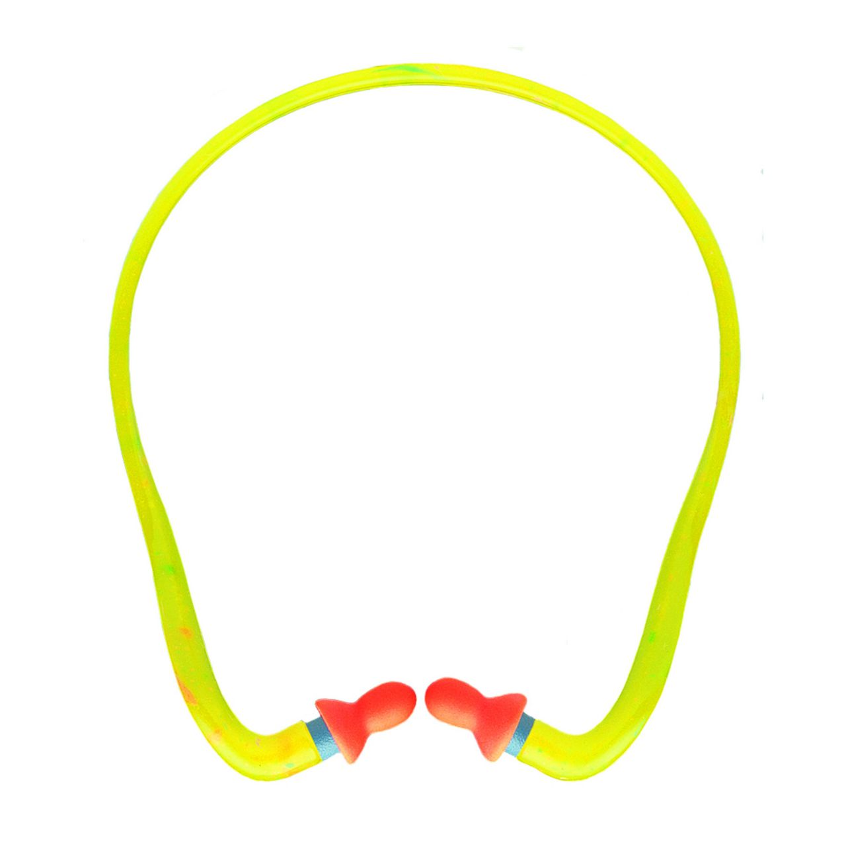
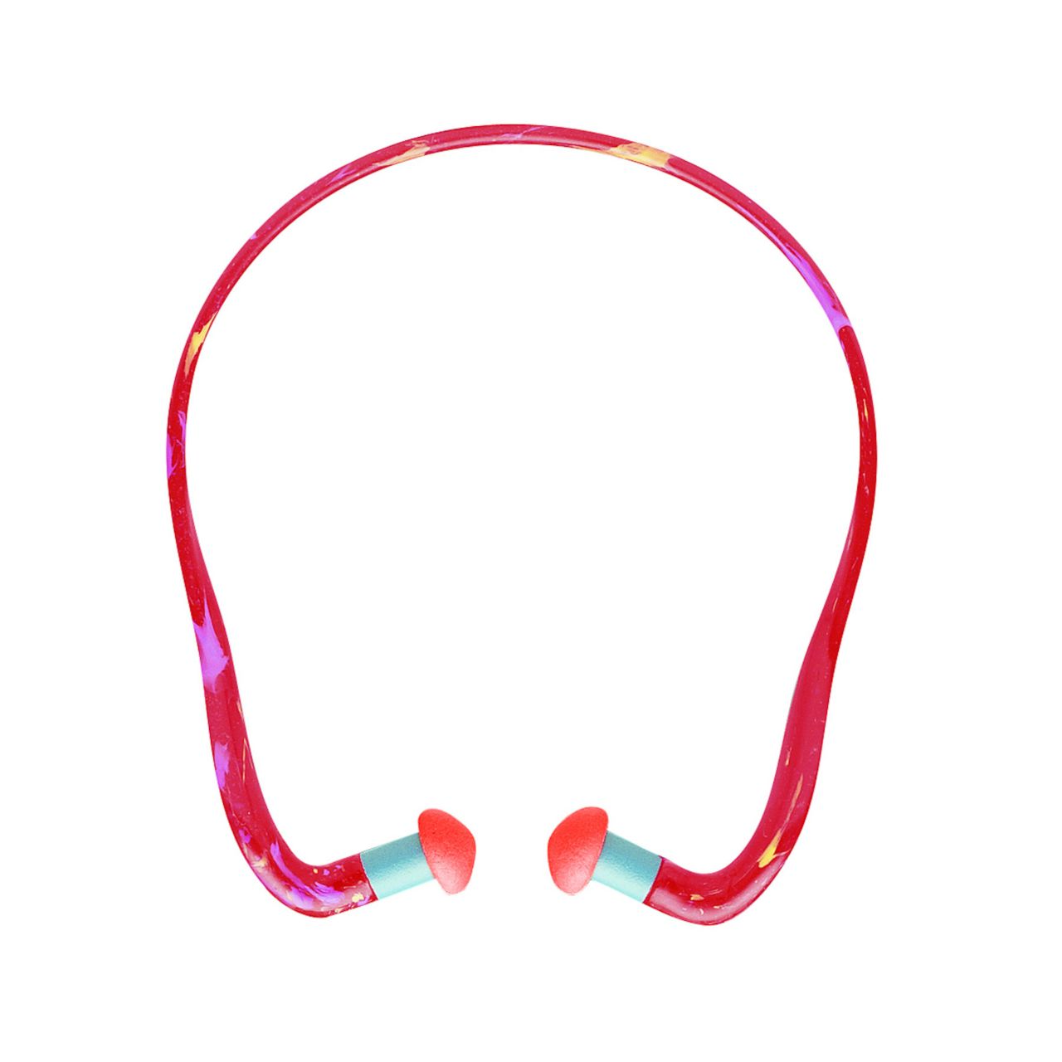
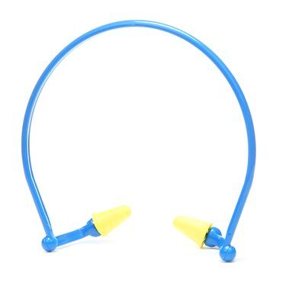
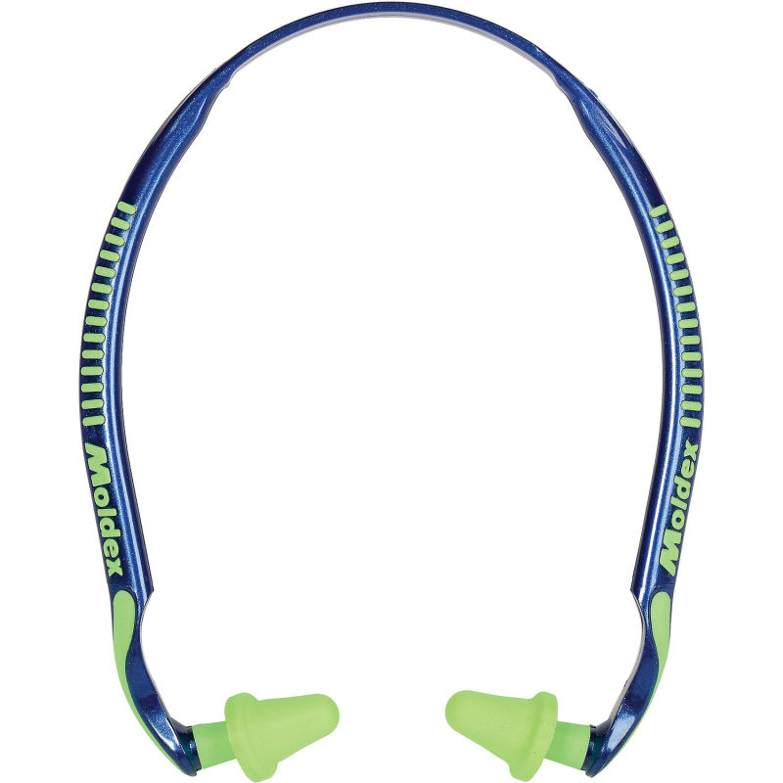
Examples of Canal Caps
Banded hearing protectors;
NRR: 25 dB
Inner-aural protectors;
NRR: 27
Semi-aural protectors;
NRR: 23
Canal caps;
NRR: 25 dB
Notes:
Examples of canal cap hearing protectors.
Please note, these images are for example purposes only, and do constitute an endorsement of the products

Slide 48
Custom Molded Earplugs
Made for the individual:
Commercially prepared
Self-made
Noise Reduction Ratings:
Very good in professionally-made sets
Potential to be inadequate in self-made sets
Reusable and durable
Notes:
Custom molded earplugs are molded for each individual from their ears.
Commercially prepared custom hearing protectors are often made by audiologist’s offices, hearing aid companies, or others. Typically, a wax model is made from each ear, the model is then used to create a mold. The mold is used to make a custom set of silicone/rubber ear plugs.
Self-made custom molded hearing protector kits can be purchased from numerous outlets. The process typically involves mixing two soft, putty-like compounds that are then pressed into the concha (part of ear leading to canal) and opening of the canal. The material is allowed to cure into firm, but pliable earplug.
Noise Reduction Rating: Custom molded earplugs can have very high NRRs, especially those that are professionally produced. However, self-made custom plugs have the potential to be formed incorrectly and have leaks through which sound pressure can enter.
Reusable and durable: With proper care and cleaning, professionally-made custom earplugs will offer adequate protection for the user over a long period of time.

Slide 49
Duel Hearing Protection
What is it?
Earplugs and muffs used simultaneously
Why use duel hearing protection?
Provide better protection from noise in high noise environments
Limitations:
Duel protection does not protect against bone conduction noise exposure
Notes:
Duel Hearing Protection: This is the use of two different hearing protectors (earplugs and muffs) in tandem to offer better protection in higher noise environments. Duel protection is often used when noise levels exceed 100 dBA or 105 dBA, however, there are limitations to the effectiveness of duel protection in preventing hearing loss.
Limitations: The effectiveness of duel hearing protection is limited by the bone conduction associated with extremely loud noise. When workers are exposed to continual sounds in excess of 120 dBA or higher, the implementation of engineering controls to reduce noise levels is highly recommended in lieu of relying solely on duel hearing protection.
Bone Conduction: This is when sound pressure waves are passed from the air into the bones of the skull (especially the jaw), the vibrations reach/vibrate the inner ear and are interpreted as sound. This capability can be used for hearing exams and is used for “bone-conduction” headphones. However, in workers exposed to extremely loud noises, bone conduction can lead to hearing loss, even if duel hearing protector NRR appear to be adequately protective. Some data indicates that bone conduction from long-term exposure to sounds as low as 105 dBA can lead to hearing loss due to bone conduction.

Slide 50
“Mechanical” Hearing Protectors
“Powered” hearing protectors
Use technology to eliminate or modify ambient sound
Active Sound Cancellation
Remove noise with inverse sound waves
Electronic hearing protection
Reduce exposure by decreasing volume of ambient sounds
Notes:
Mechanical hearing protectors: These types of hearing protectors are battery operated. They use technology (microphones, processors, and amplifiers) to eliminate, reduce, or increase ambient sounds.
Active sound cancellation: This type of hearing protector analyzes the ambient sound, then creates an inverse sound wave. The two waves cancel each other and the result no or much less noise.
Electronic Hearing Protection: This type of mechanical protection utilizes the typical sound isolation earplugs or earmuffs that have special electronics built into them. They have a microphone and processor to measure sound outside the protector, and a volume control to transmit the appropriate level sound into the ear. These devices are designed to reduce loud sounds and increase low sounds.
These technologies can be used with earplug and earmuff hearing protectors. Additionally, some electronic hearing protectors can be coupled with communication systems to permit worker communications while controlling potential noise exposures.
A disadvantage for these devices is cost. They can cost $100 to over $300.

Slide 51
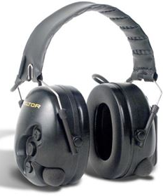
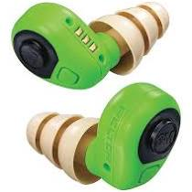
Examples of Mechanical Hearing Protectors
Electronic earplugs
Electronic earplugs
Electronic earmuffs with Bluetooth technology for communication systems
Notes:
Examples of electronic hearing protectors.
Please note, these images are for example purposes only, and do constitute an endorsement of the products

Slide 52
Closing Statements
Loud sounds are prevalent throughout industry
Noise-Induced Hearing Loss is a common problem that can be corrected
A comprehensive and fully implemented hearing Conservation program is essential in preventing occupational noise-induced hearing loss
Notes:
Hearing is a very important part of our daily lives that is often taken for granted until significant damage has occurred. Complete or partial hearing loss does not have to be part of working in industry. The use of proper controls can reduce risks of hearing loss, and routine evaluations of workers’ hearing sensitivity can identify potential hearing changes before they become significant. An effective Hearing Conservation program must include management and employees working together to utilize the best practices for protecting worker hearing.

