Slide 1
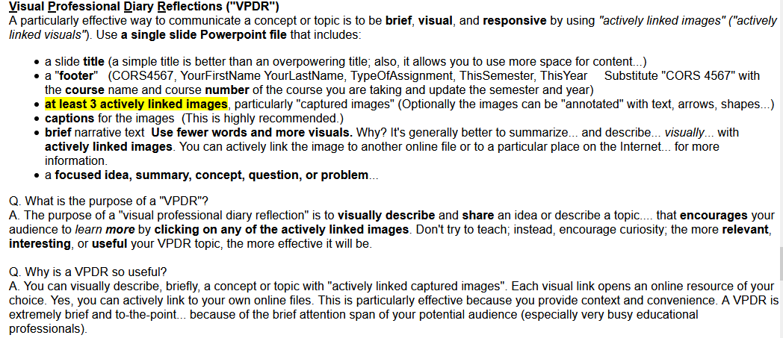
https://ulm.edu/~beutner/format/Design-And-Format-Guidelines-For-This-Course.html#Visual_Professional_Diary_Reflection

