Slide 1
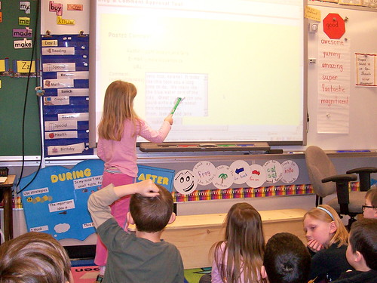
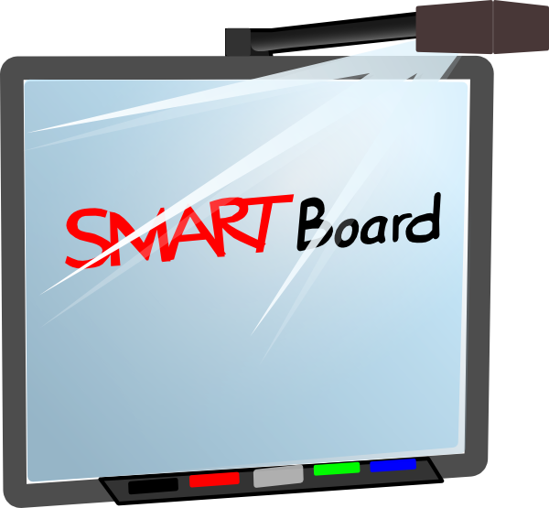
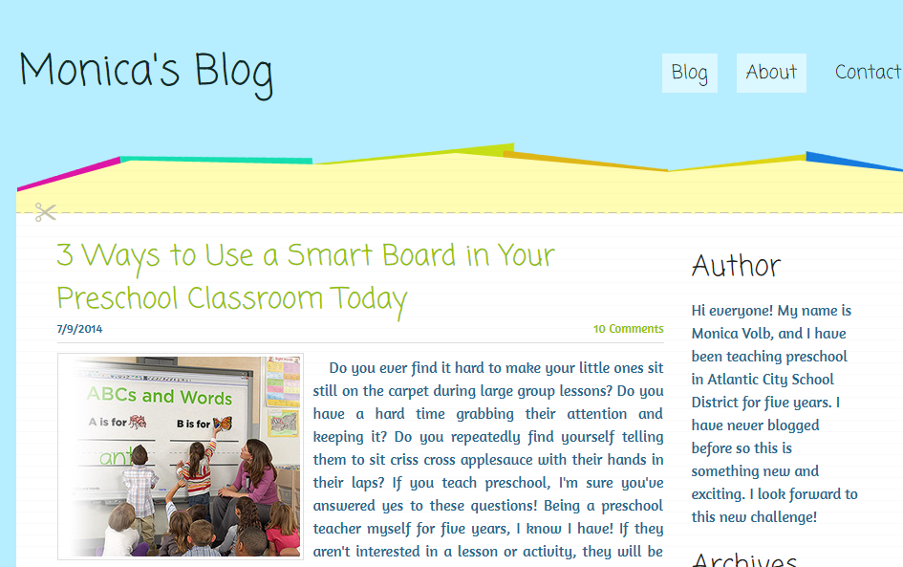
Basic Orientation for Using Smart Boards in Early Childhood Classrooms
The National Association for the Education of Young Children promotes the use of technology in the classroom.
Smart Boards open up a technological world for the teacher and learner.
Why should we use Smart Boards in Early Childhood Classrooms?
There are creative and interactive uses that make learning fun!
"They are growing up at ease with digital devices that are rapidly becoming the tools of the culture at home, at school, at work, and in the community." NAEYC’s position statement for technology in Early Childhood.
CURR 5018, Course Project Files, Kerri Kannady, Summer 2019

Slide 2
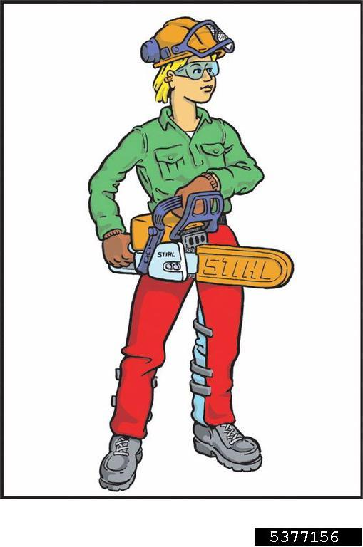
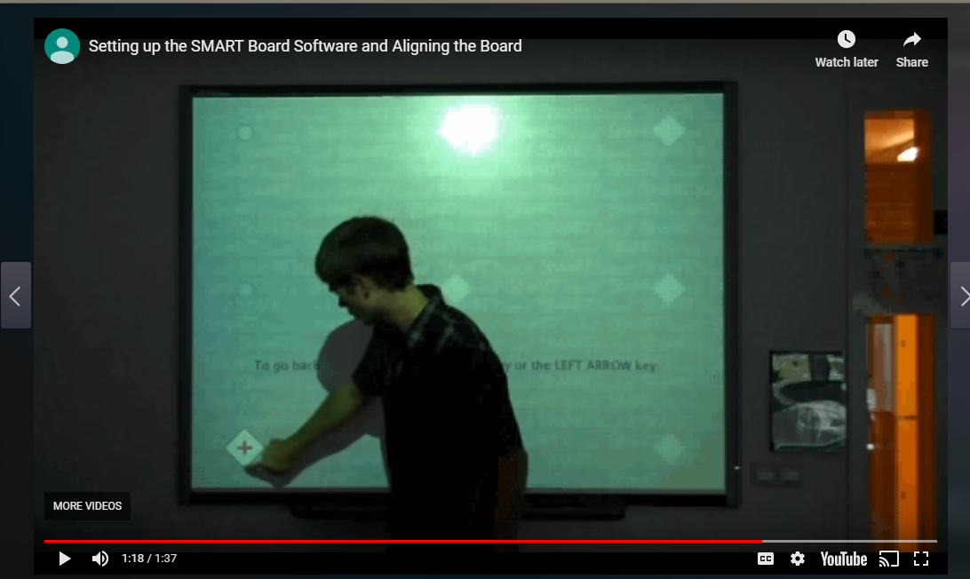
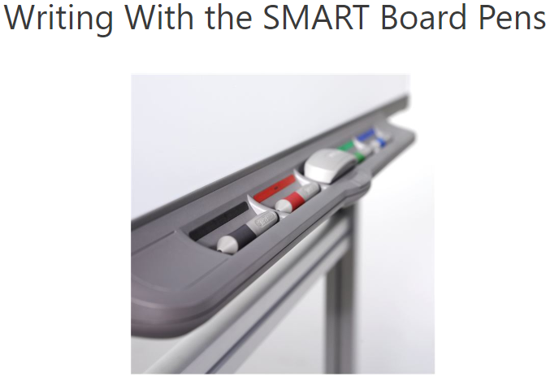
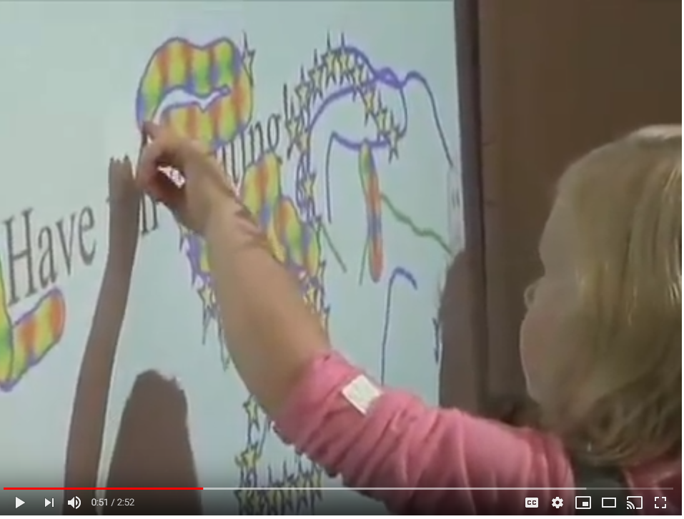
Basic Orientation for Using Smart Boards in Early Childhood Classrooms
It may feel like a big job to learn how to operate the Smart Board, but you can use it and be successful!
Pick up the pen from the color tray.
Once the pen is removed from the tray you can use the pens, tennis balls or fingers to write on the Smart Board.
How do I operate a Smart Board?
This video clearly explains the calibration or orienting process.
Operating the Smart Board is as easy as using your hand, fist or tennis ball. There are two buttons on the front that can be used in aligning and to double, left or right click.
CURR 5018, Course Project Files, Kerri Kannady, Summer 2019

Slide 3
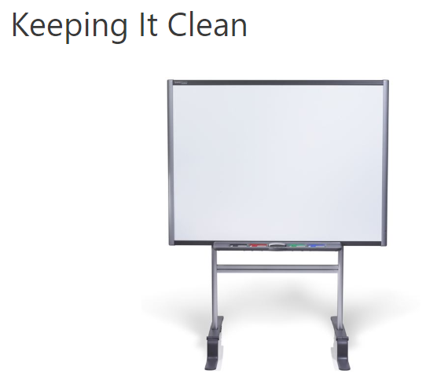
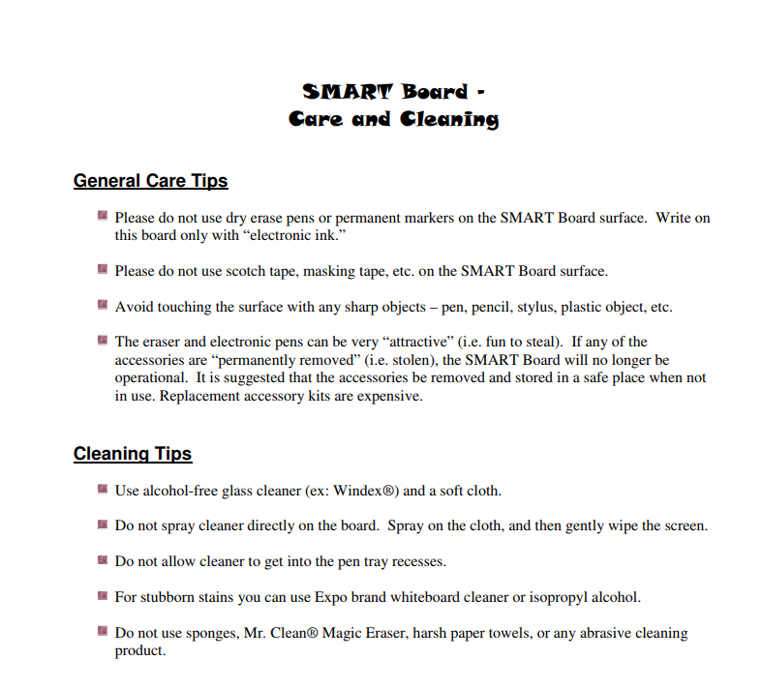
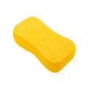
Basic Orientation for Using Smart Boards in Early Childhood Classrooms
How do I take care of my classroom Smart Board?
Children will learn so much from the interactive use of Smart Boards. We all know how hard the constant use is on classroom equipment.
Only use these type of pens. NEVER use dry erase markers on Smart Boards. Tape should not be put on the Smart Board surface and could ruin the screen.
A damp sponge (using mild soap) is useful in cleaning off fingerprints or dust from Smart Boards.
CURR 5018, Course Project Files, Kerri Kannady, Summer 2019

Slide 4
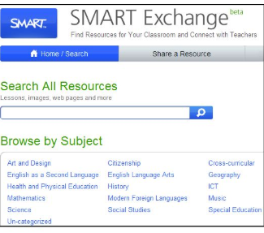
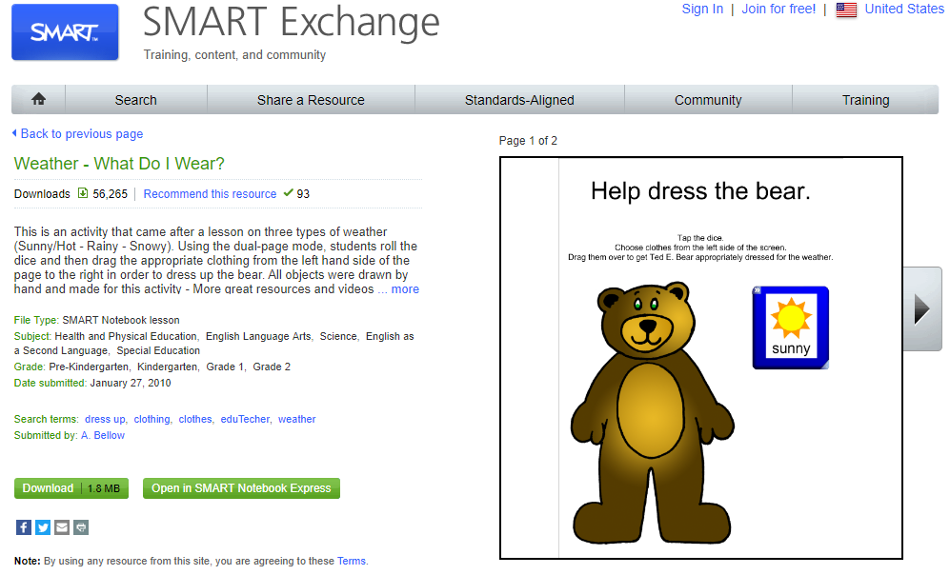
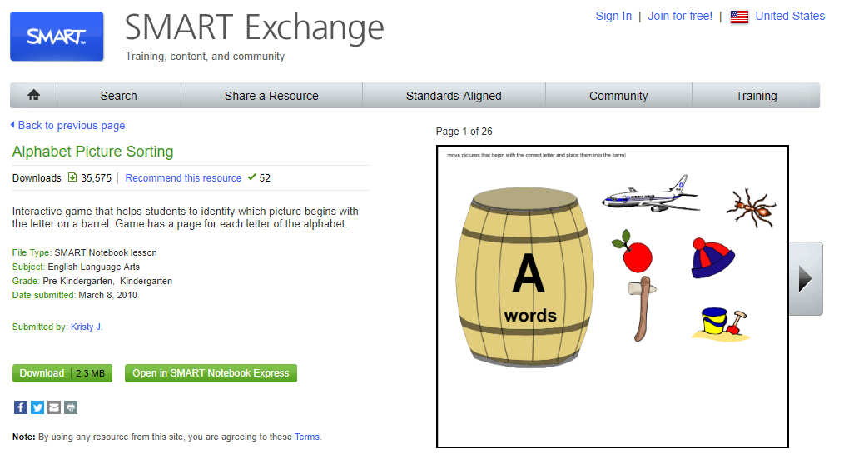
Basic Orientation for Using Smart Boards in Early Childhood Classrooms
There are specific topic searches for Content Standards related lessons and lessons that match the particular curriculum your district uses.
How do I use the Smart Exchange website to find free games?
CURR 5018, Course Project Files, Kerri Kannady, Summer 2019

Slide 5
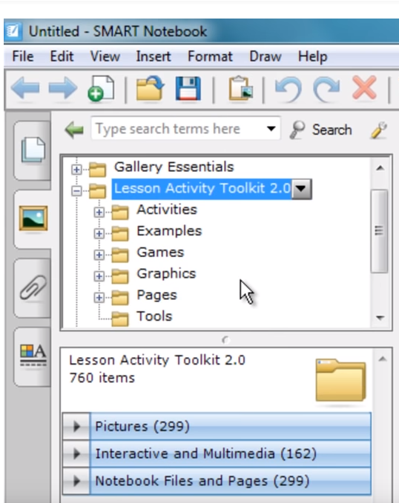
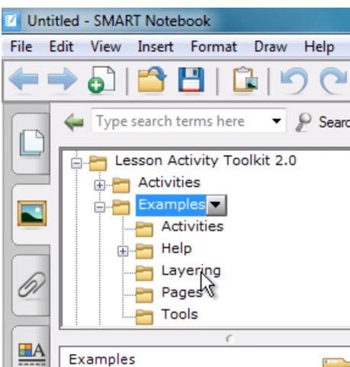
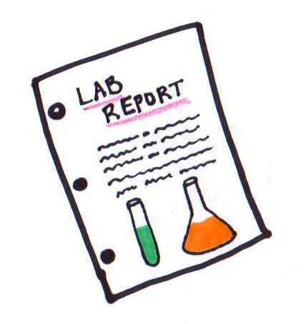
Basic Orientation for Using Smart Boards in Early Childhood Classrooms
1. Click on the Lesson Activity Tool Kit
How can I use the Lesson Activity Builder (LAB) to design games?
First click on the icon on the left that looks like a mountain and sun image to find pictures. Then click on the puzzle piece to make the game interactive and to use the activity builder.
2. Click on Examples to choose from templates for activities.
CURR 5018, Course Project Files, Kerri Kannady, Summer 2019

Slide 6
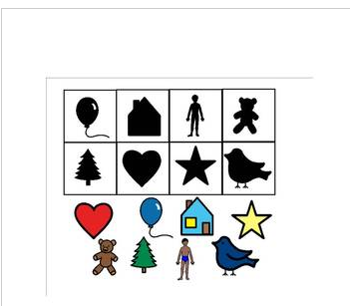
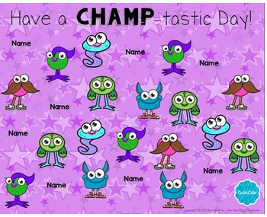
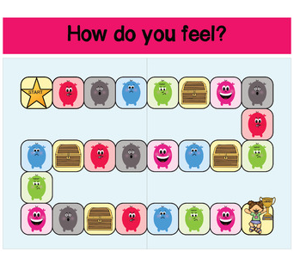
Basic Orientation for Using Smart Boards in Early Childhood Classrooms
What are some Smart Board interactive games for language arts lessons?
Memory and puzzle games
https://www.kinderplans.com
A free attendance chart for the student to find their name and click to see a gonoodle champ.
How do you feel? Emotions board game.
CURR 5018, Course Project Files, Kerri Kannady, Summer 2019

Slide 7
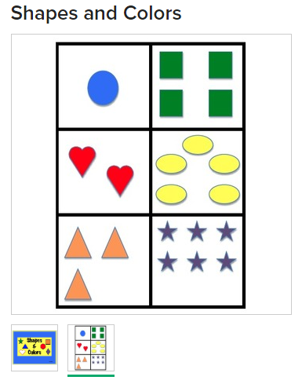
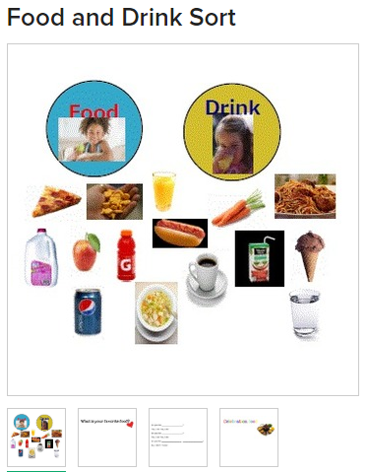
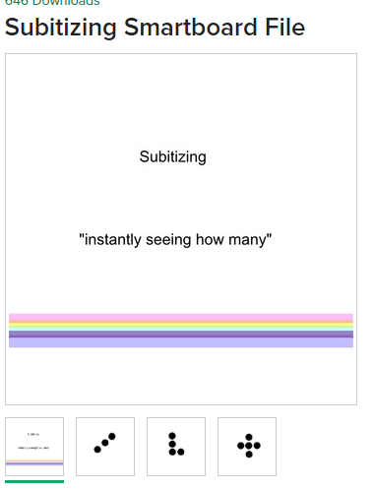
Basic Orientation for Using Smart Boards in Early Childhood Classrooms
What are some Smart Board interactive games for math lessons?
Bright and colorful to catch attention and use for identifying shapes and counting.
A drag and drop game to sort types of food.
Play the game, “Tell Me Fast” .
CURR 5018, Course Project Files, Kerri Kannady, Summer 2019
This Photo by Unknown Author is licensed under CC BY-SA-NC

