Slide 1
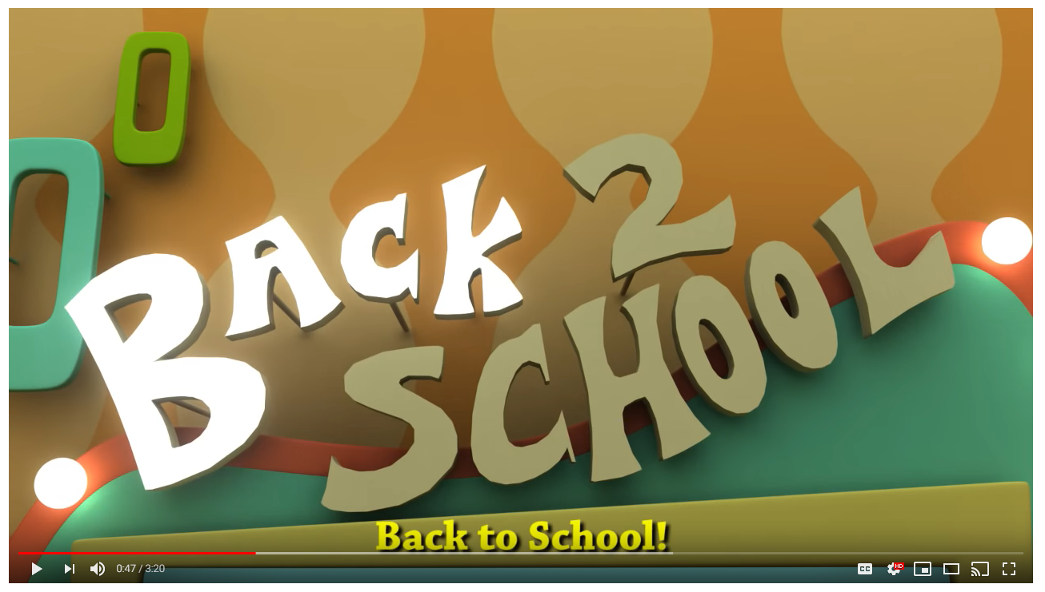
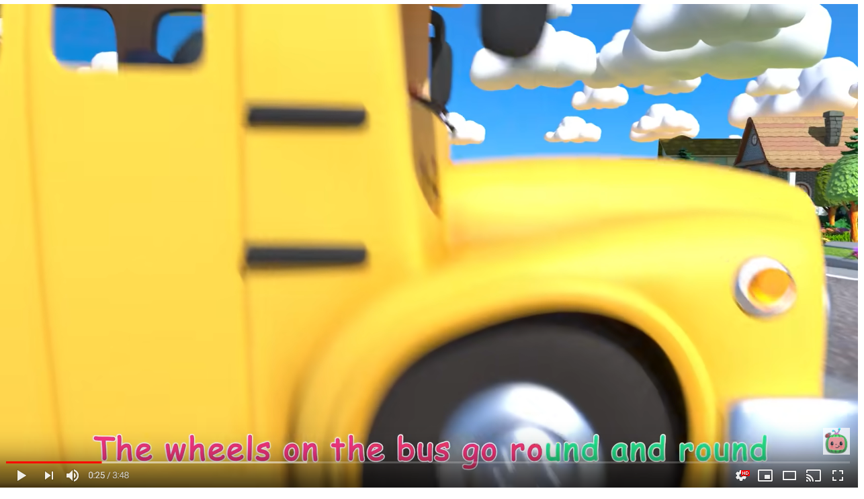
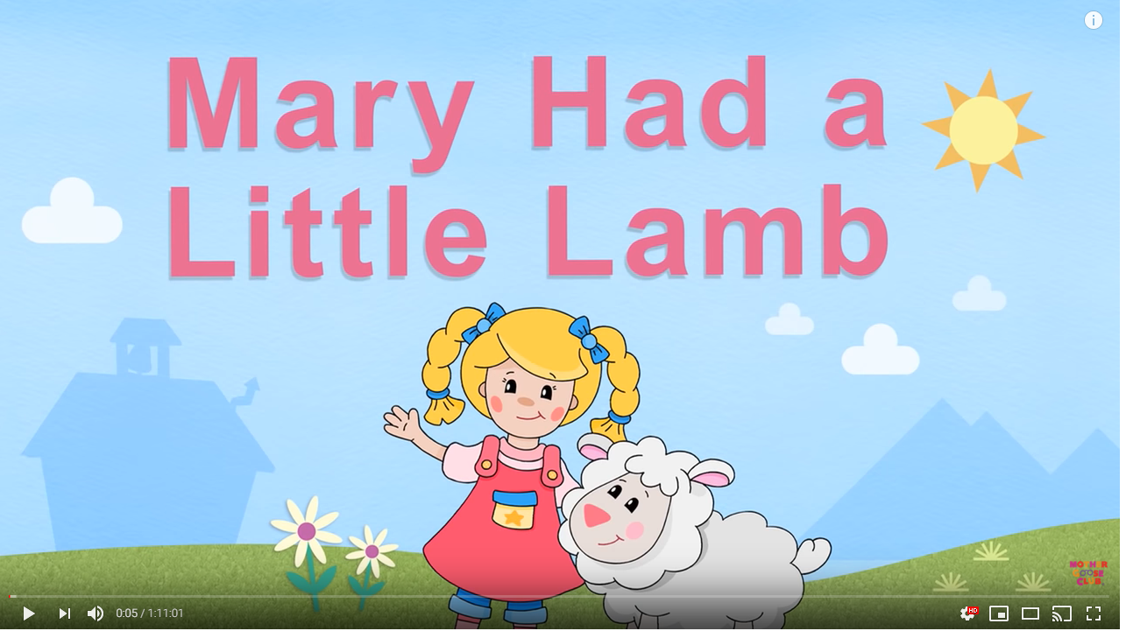
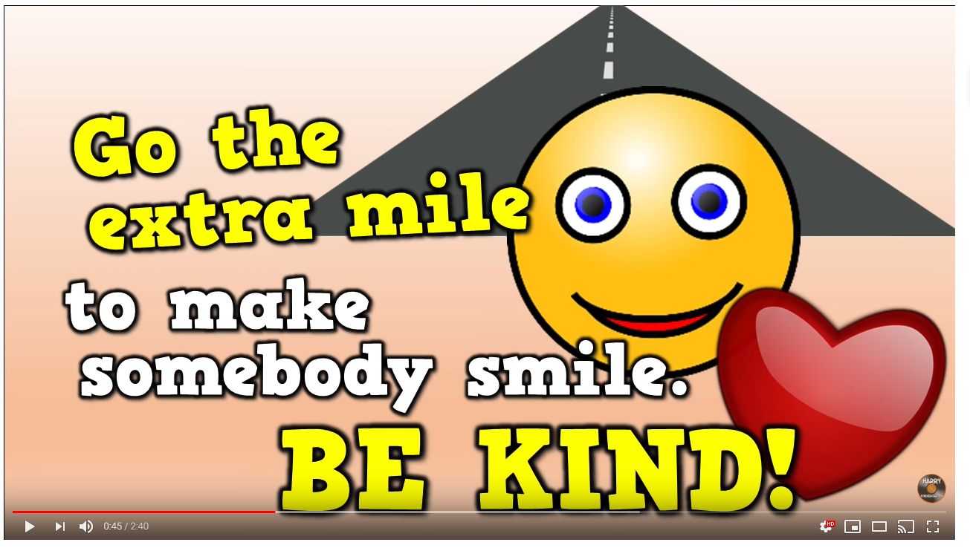
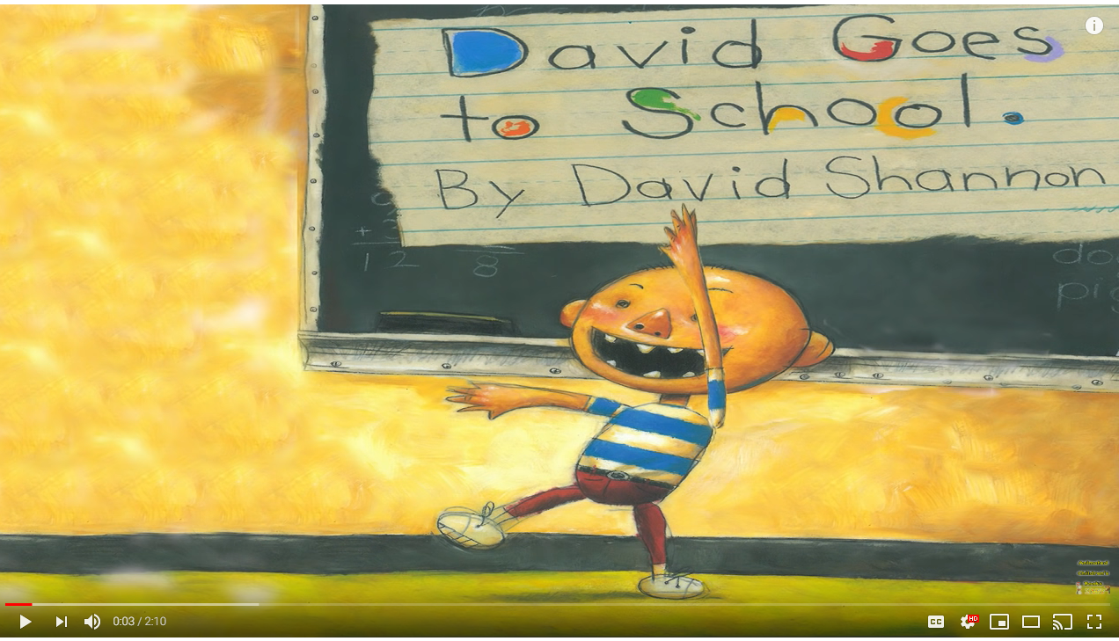
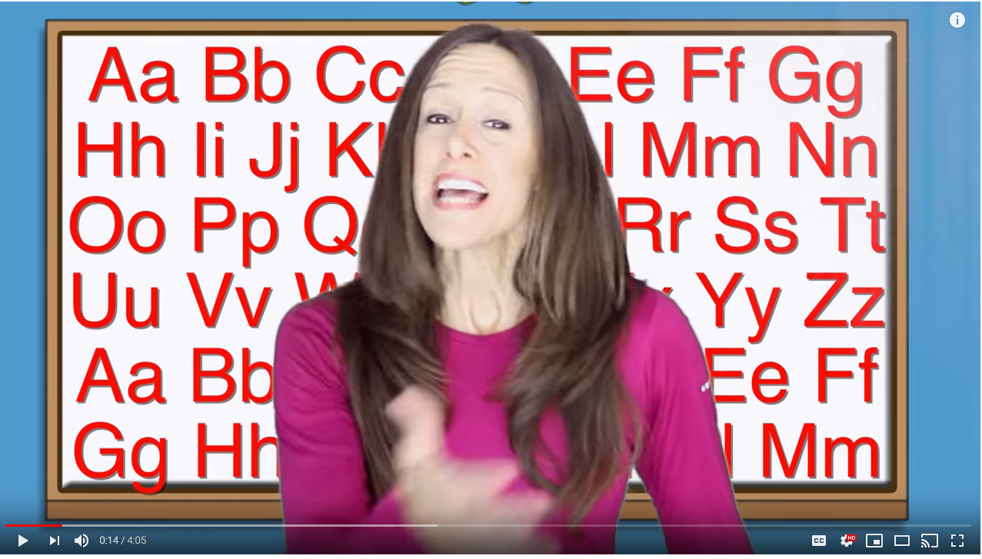
Youtube Videos for Welcome to Pre-Kindergarten School Study
Cute animated video about school and rules. Sign language is also taught with key vocabulary.
The Wheels on the Bus song is a simple, active learning song.
Students can sing along and recognize the rhyming words.
The book David Goes to School entertains and educates children about what NOT to do in school.
Singing the alphabet sounds and signing.
Harry Kindergarten song all about kindness at school.
CURR 5018 Kerri Kannady VPDR Summer 2019

